Slide 1
Social Media:
Management, Analytics, & Marketing
T. Meredith, UWE Ed Tech Specialist
April 25, 2017

Slide 2
Why bother with social media?
Social media is a no/low-cost method for reaching members of the public, especially in rural or weather-challenged areas
Tracking statistics can help with strategic planning for focused marketing and/or goal-setting
Establishing cost-per-contact/engagement helps with budget estimates for future funding requests or grant applications
ET&P reporting

Slide 3
NOTE:
The only people that see your content are your followers – unless it is “shared” by others or
you pay for advertising!

Slide 4
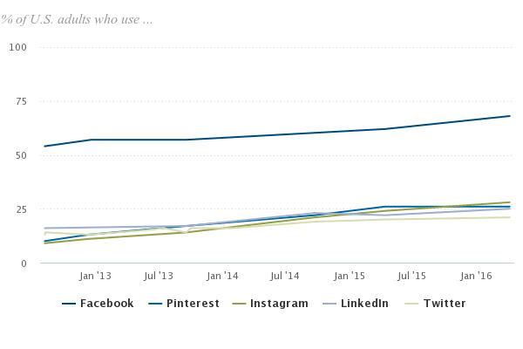
Popular Social Media Tools
For rural populations:
Facebook (65%)
Instagram (25%)
Pinterest (20%)
Twitter (19%)
68% 26% 28% 25% 21%
Data from Pew Research Center, “Social Media Fact Sheet” – January 12, 2017

Slide 5
Account Management
Facebook
Have multiple administrators
Use a “professional” profile to manage, not personal
Post as your “Page,” not your individual profile
Schedule posts in advance
Have content disclaimer (“The opinions expressed on this page are not necessarily those of UW…”)
Keep images, admins, & contact info updated

Slide 6
Account Management
Instagram
Tied to a single email/account--share login info OR only use one device
Can only post from mobile device (tablet or phone) but can view from computer
Can set up so that any Instagram post is automatically sent to Facebook, but NOT vice-versa
Create obvious username (including WY, UWYO, Wyoming, etc.)
Requires circular profile image – may need graphic editing tool

Slide 7
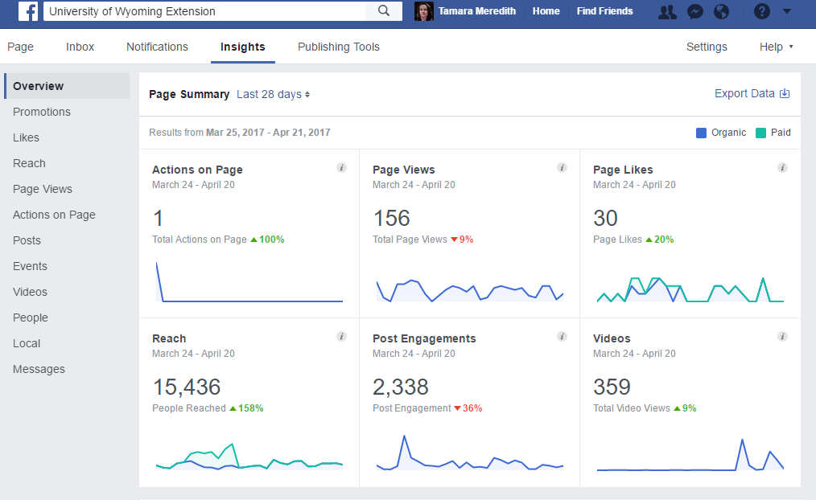
Analytics
What can I track?
Facebook: # of likes, followers, posts, etc.
Instagram & Twitter: # of followers, posts, likes, etc.
Pinterest: Avg. # of viewers, engagement, pins, etc.

Slide 8
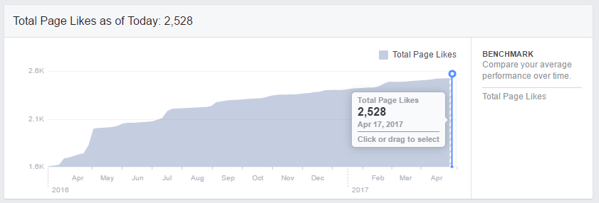
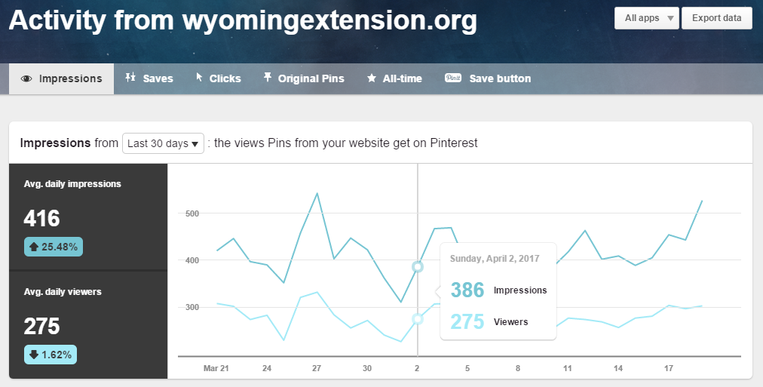
Collecting Data
How often should I collect social media data?
Each tool has different windows of data visibility
Facebook: 1+ years
Instagram: 7 or 30 days
Pinterest: 7, 14, or 30 days
Best practice: capture basic data (likes, followers, posts, etc.) once each month on the same day OR aggregate totals throughout the year for an annual report

Slide 9
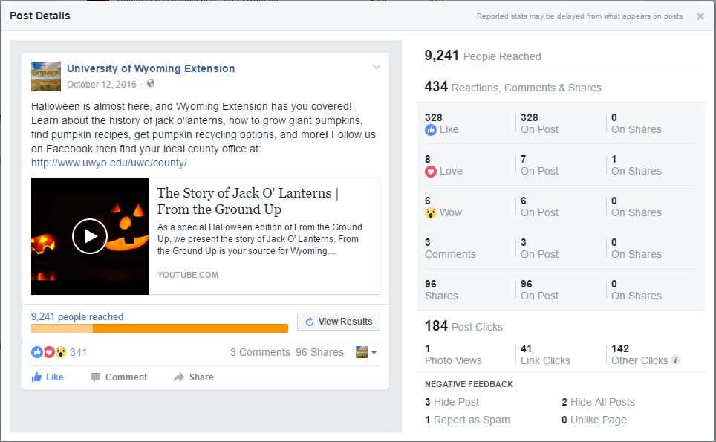
Marketing
Facebook Ads & “Boosted” posts
“Boost” a post, create a new ad, or advertise an event by paying to have it shown to people who are not (yet) your followers
Audience determined by demographics you select: age, interests, location (zip code), etc.
Requires a credit card tied to Facebook account
You will get deep analytic data about who saw the ad, including demographics, access type, etc.

Slide 10
Activity
Get credit toward your “Tech-spert” badge!
Do a quick assessment of your office’s main social media presence
OR
Document your office’s main social media stats (likes, followers, etc.)
When you have finished, go to this Google form and fill it out to receive credit:
http://tinyurl.com/10thingsApril

Slide 11
Questions?
Tamara Meredith, tamara.meredith@uwyo.edu

