Slide 1
Google Forms
T. Meredith, UWE Ed Tech Specialist
August 22, 2017

Slide 2
Uses for Google Forms
Survey/Feedback
Assessment/Evaluation
Program Proposals
RSVP
Registration
Reservations
Quiz

Slide 3
Creating a Google Account
Note: you do not need a Gmail address – you can use your work email “@uwyo.edu” to create a Google account. Enter it into the “Your email address” field.
Once you have created a Google account and logged in, you will see several options including a grid in the upper right-hand corner.
Click on the 3x3 grid to see all Google Tools
Use Google Drive to access Forms

Slide 4
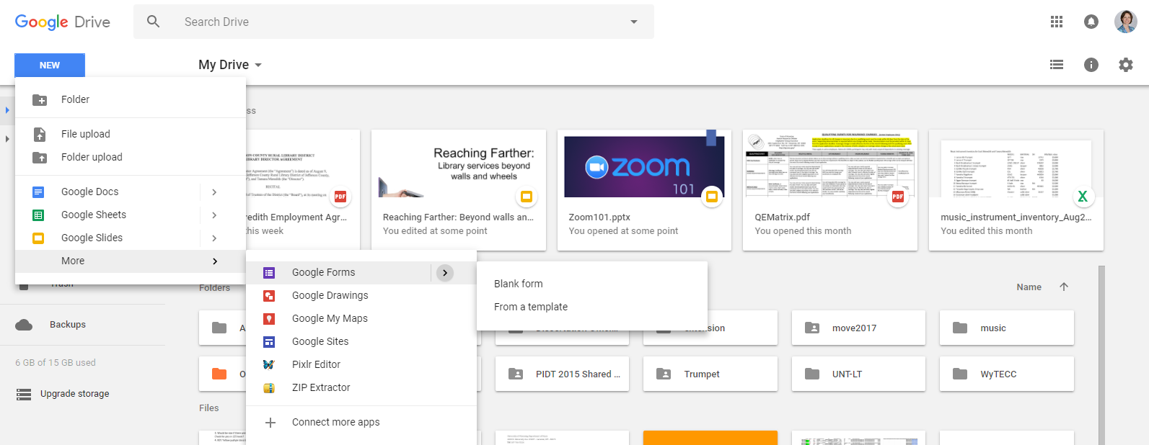
Creating a New Google Form

Slide 5
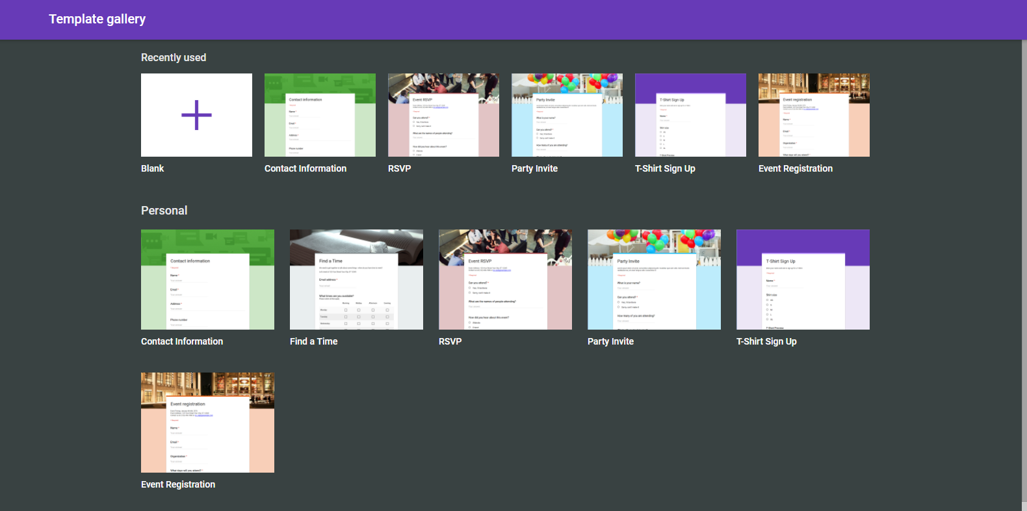
From a Template

Slide 6
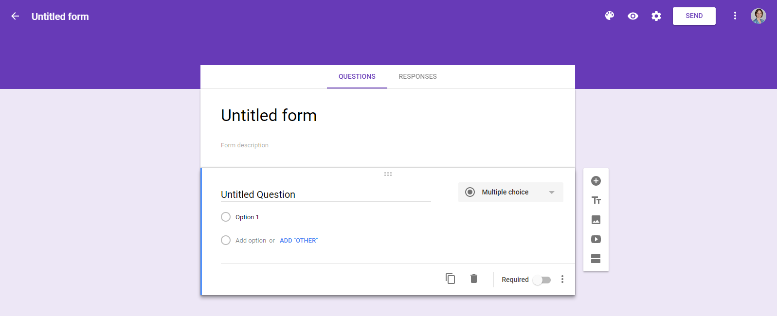
Creating a Form from Scratch
Name your form
Settings
Background
Preview
Require a Response

Slide 7
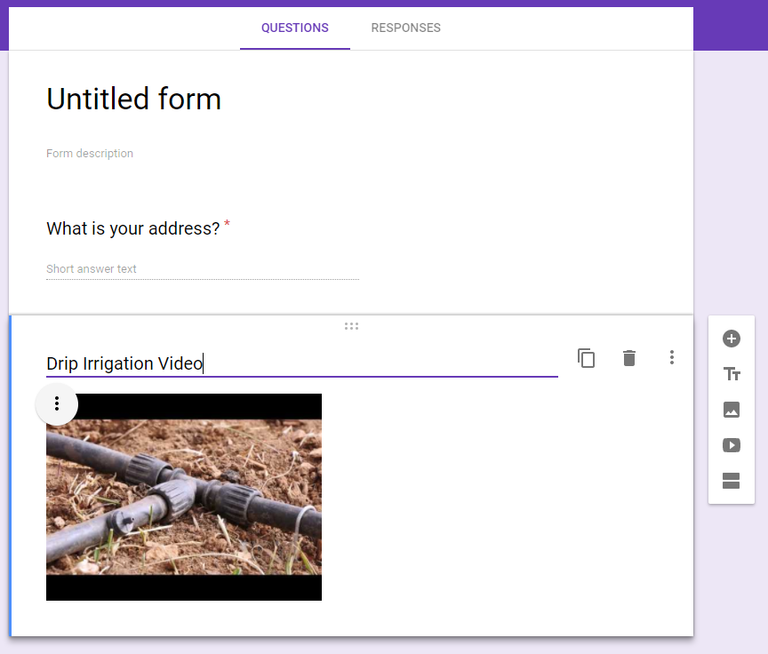
Adding Elements
Add a Question
Header/Text
Image
Video
New Section/Page

Slide 8
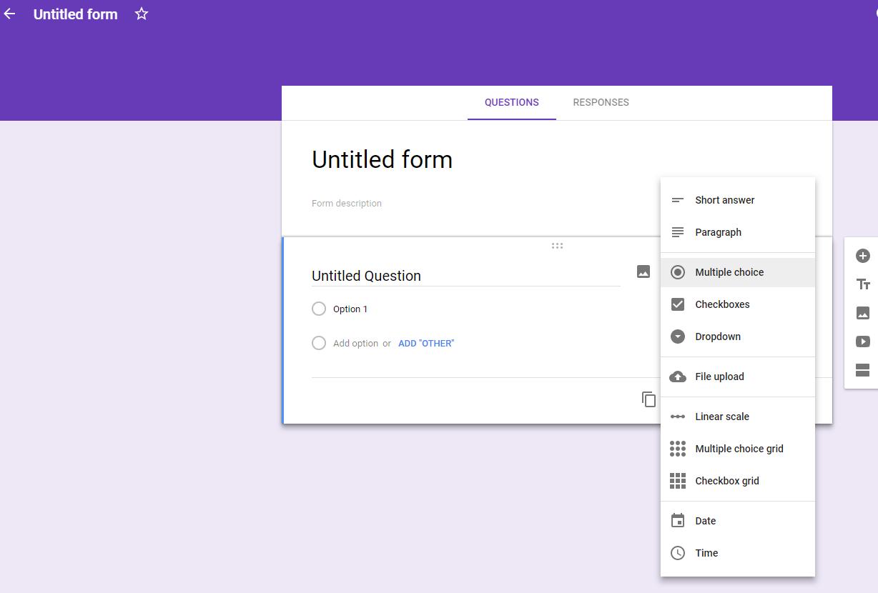
Question Types
Short/Long Answer
Multiple Choice
Checkbox/Dropdown
Upload a File
Likert Scale
Grid
Date
Time

Slide 9
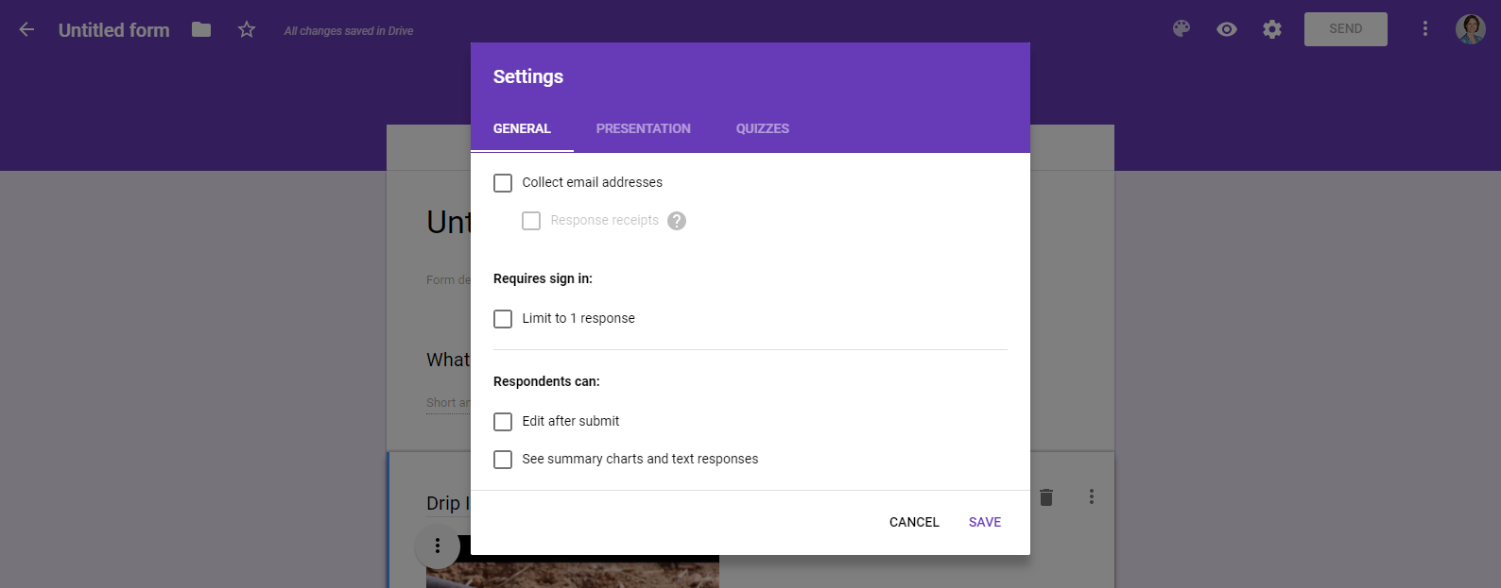
Settings
Limit to One Response

Slide 10
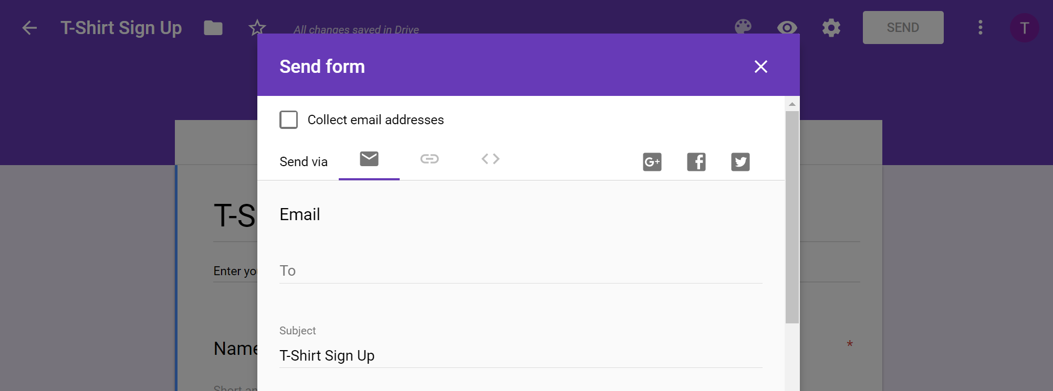
Send/Share Form
Email or Get a Link

Slide 11
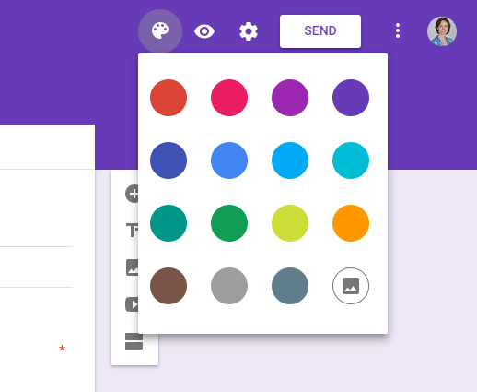
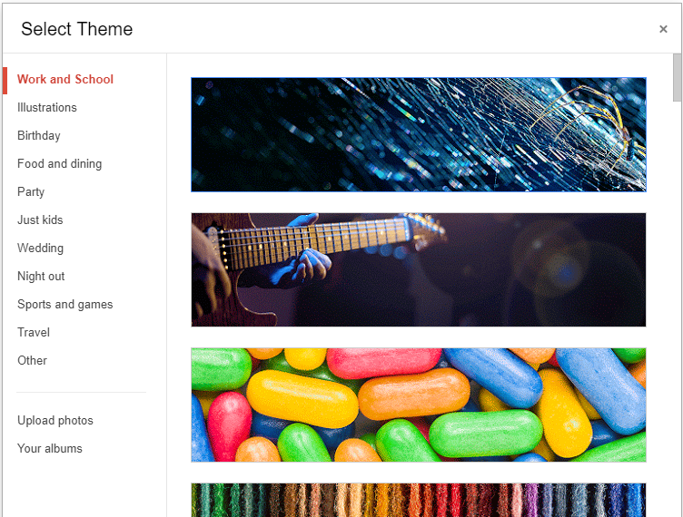
Changing the Background
Select the Palette Tool
Choose a Theme or Upload Your Own Photo
Insert an Image

Slide 12
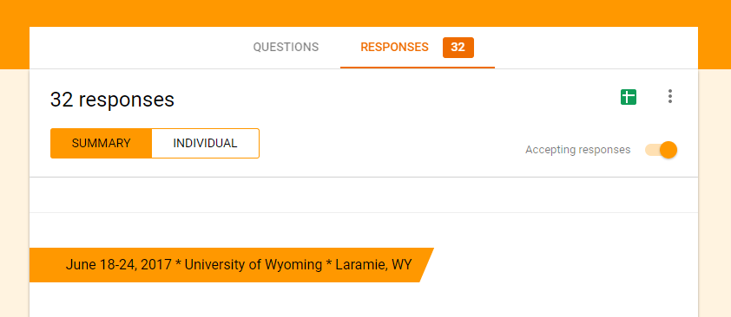
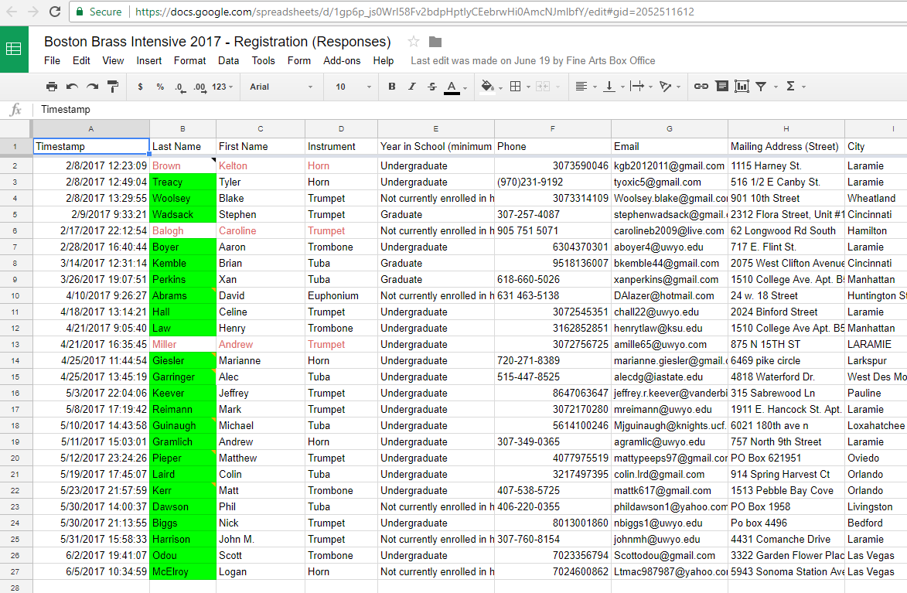
Responses
Individual or Summary of Responses
Total #
Create Spreadsheet
Spreadsheet can be downloaded as Excel document

Slide 13
Activity
Get credit toward your “Tech-spert” badge!
Create a Google form and send it to someone
OR
Download data from a Google form
When you have finished, go to this Google form and fill it out to receive credit:
http://tinyurl.com/10thingsAugust

Slide 14
Questions?
Tamara Meredith, tamara.meredith@uwyo.edu

