Slide 1
EDpuzzle
T. Meredith, UWE Ed Tech Specialist
October 2017

Slide 2
Why interactive videos?
Web-based, accessible
Create mobile-ready content, available 24/7
Embed quizzes, prompts, etc. for immediate feedback, or
Capture learner data for later assessment and feedback
Easily edit/customize based on learner needs
EDpuzzle.com
Started in 2013
Free for teachers
Strong support/tutorials

Slide 3
About EDpuzzle
Easy registration – name and password only (no email required)
Use your own videos or others
Easily trim videos – only use what you need
Share links to lessons via email or post on website
Collect user data

Slide 4
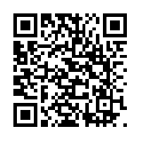
Sample Video
http://tinyurl.com/UWEedpuzzledemo

Slide 5
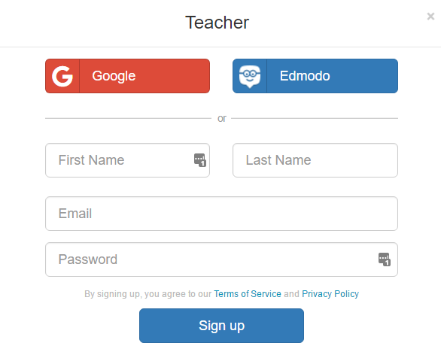
Creating an Account
EDpuzzle is FREE for educators
Simple registration process
“Gradebook” functionality is only available to Premium (institutional) members

Slide 6
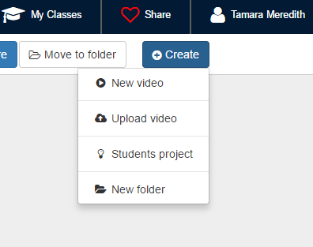
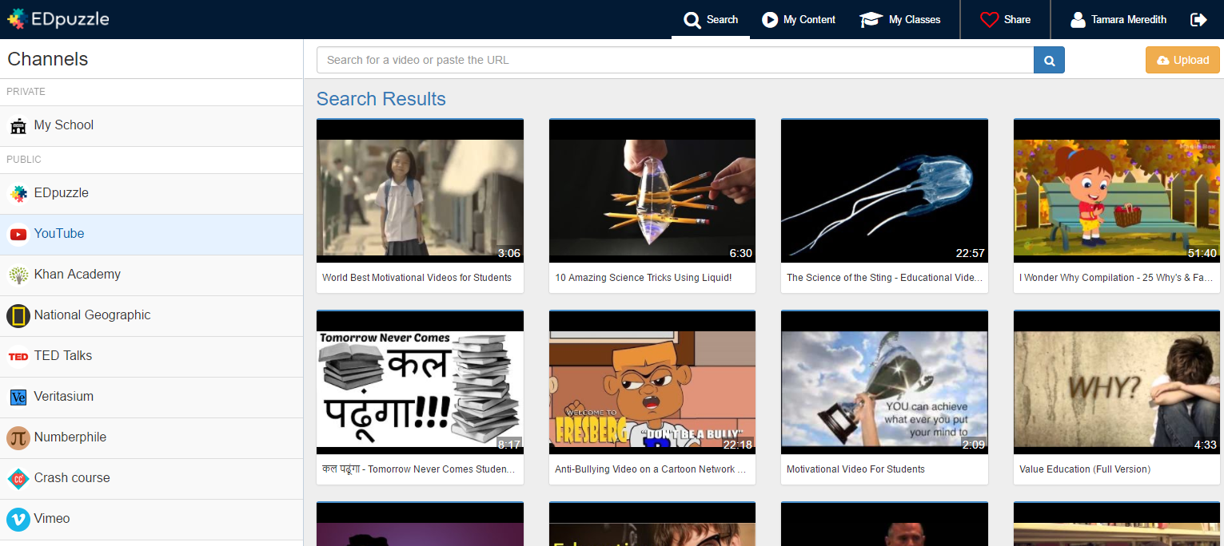
Finding/Adding a Video
Search for a video OR enter a URL
Click
“Create”

Slide 7
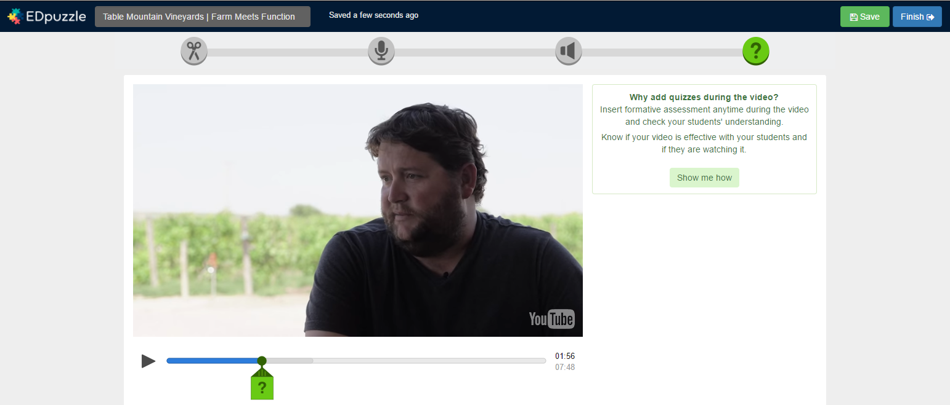
Editing Tools
Crop/Trim
Audio Track
Audio Notes
Quizzes
All edits are auto-saved every few seconds

Slide 8
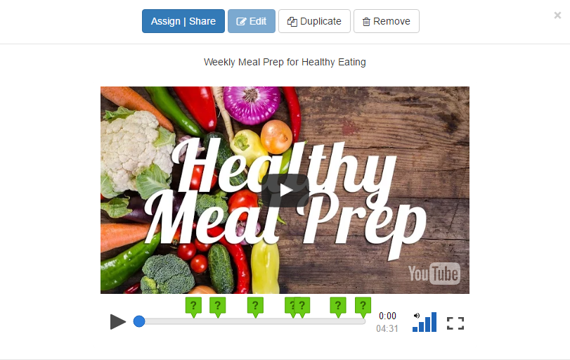
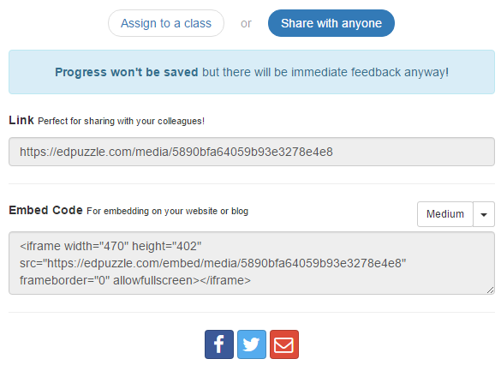
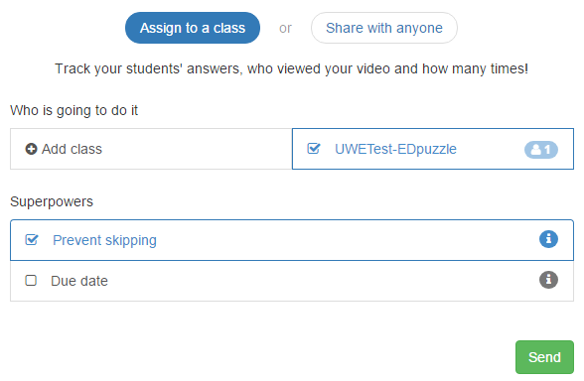
Sharing Video Lessons
Sharing does not collect data but does give feedback
Assigning lets you collect student data

Slide 9
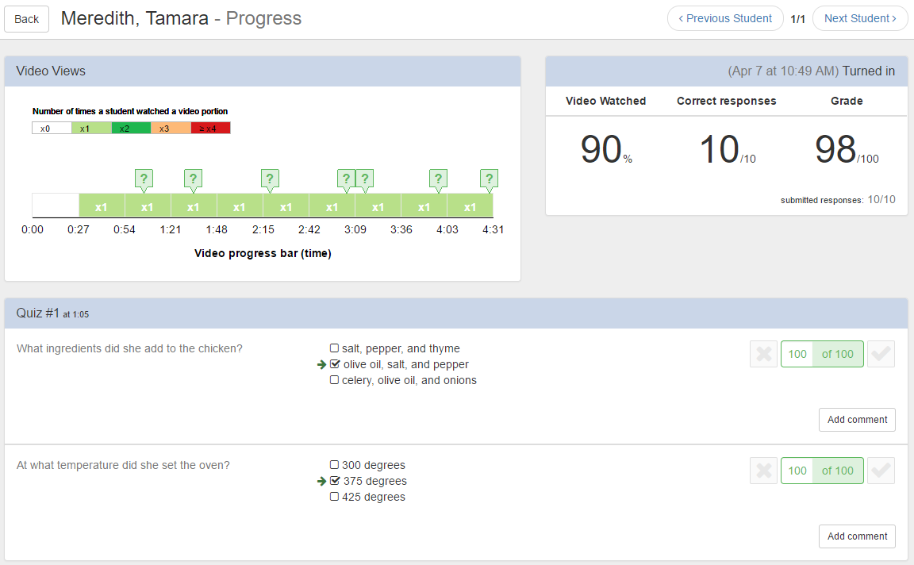
Tracking Student Data
Under “Assignments” select “Progress”
Click on the student’s name to:
See # of times viewed
View quiz answers and scores
Grade open-ended questions
Make comments on submitted work
Export student data in a CSV file

Slide 10
Copyright Issues?
EDpuzzle’s statement:
Since EDpuzzle is just streaming videos from YouTube or Vimeo through their embed APIs, we (and you) are in compliance with copyright issues. That is provided the original video isn't infringing on anything, in which case the video could be taken down at any time.
The original video still accumulates views through EDpuzzle videos… Through YouTube's embed API, pre/post-roll ads do not play, but the pop-up banner ads still show on the EDpuzzle video. This is important if the owner of the video making money from advertisers to assure their video content and ads are being seen. Again, this is in compliance with YouTube, as long as you are not making money directly off of video content that you do not own.

Slide 11
Activity
Get credit toward your “Tech-spert” badge!
Create an account at EDpuzzle.com, find/upload a UW Extension video, and try cropping or adding quiz questions to it.
OR
Create an account at EDpuzzle.com and modify one of their videos to try out cropping, editing, etc.
When you have finished, go to this Google form and fill it out to receive credit:
http://tinyurl.com/10thingsOctober

