Slide 1
YouTube Basics
T. Meredith, UWE Ed Tech Specialist
February 28, 2017

Slide 2
YouTube Accounts in Wyoming Extension
Professional videos for general public
Managed by David Keto, C&T – send to him or arrange to be added to “Manager” list for C&T YouTube account
Local/regional videos for specific projects, 4-H, limited sharing, etc.
Can be set up and managed by any Extension personnel
Suggested: use work email to setup OR use eXtension Google account

Slide 3
Creating a YouTube Account
Note: you do not need a Gmail address – you can use your work email “@uwyo.edu” to create a Google account. Enter it into the “Your email address” field.
Once you have created a Google account and logged in, you will see several options including a grid in the upper right-hand corner.
Click on the 3x3 grid to find a link to YouTube; or,
Go to http://www.youtube.com

Slide 4
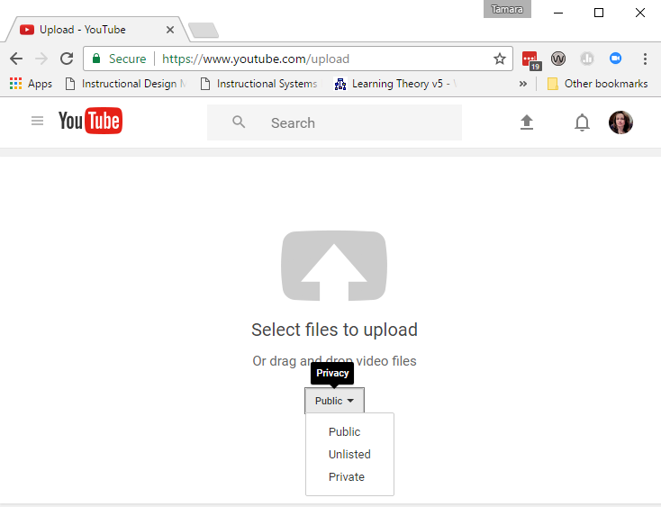
Uploading Videos
2)
1)
Click to find file on your computer
Click arrow to upload
Select the privacy setting for the video

Slide 5
What’s the difference?
Unlisted Videos
Private Videos
Unlisted videos cannot be found by keyword searching in YouTube.
Anyone with a link/URL for the video can view (it can be emailed, texted, etc. without restriction).
Private videos can only be viewed by those who have been added to a list attached to the video itself.
If someone attempts to view a Private video and has not been added to the list, they will see the following:
Most common

Slide 6
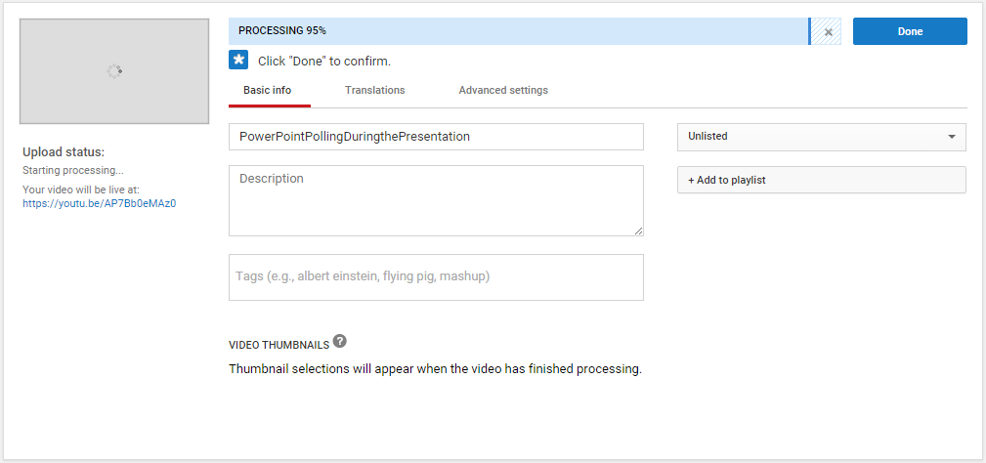
Adding Information to A Video
3)
Add a Title

Slide 7
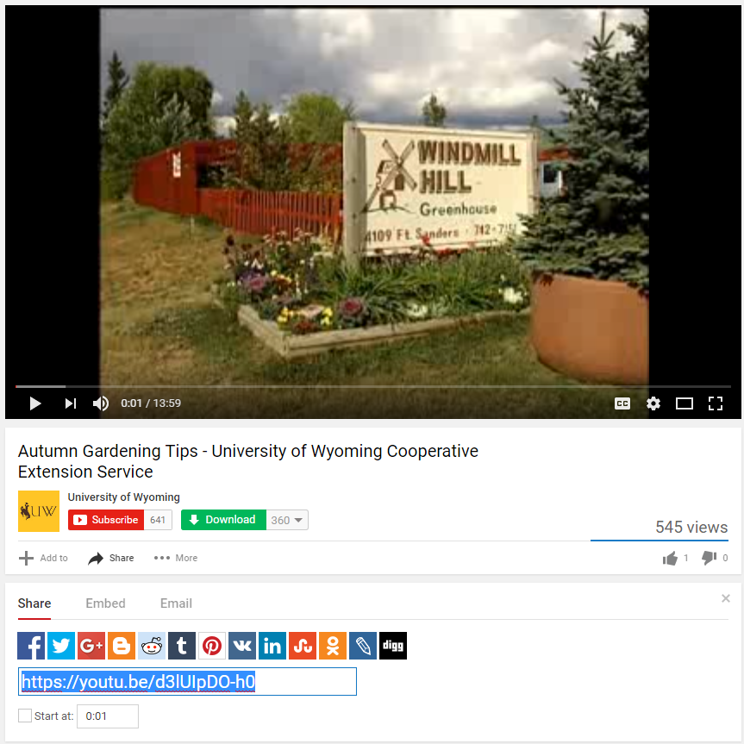
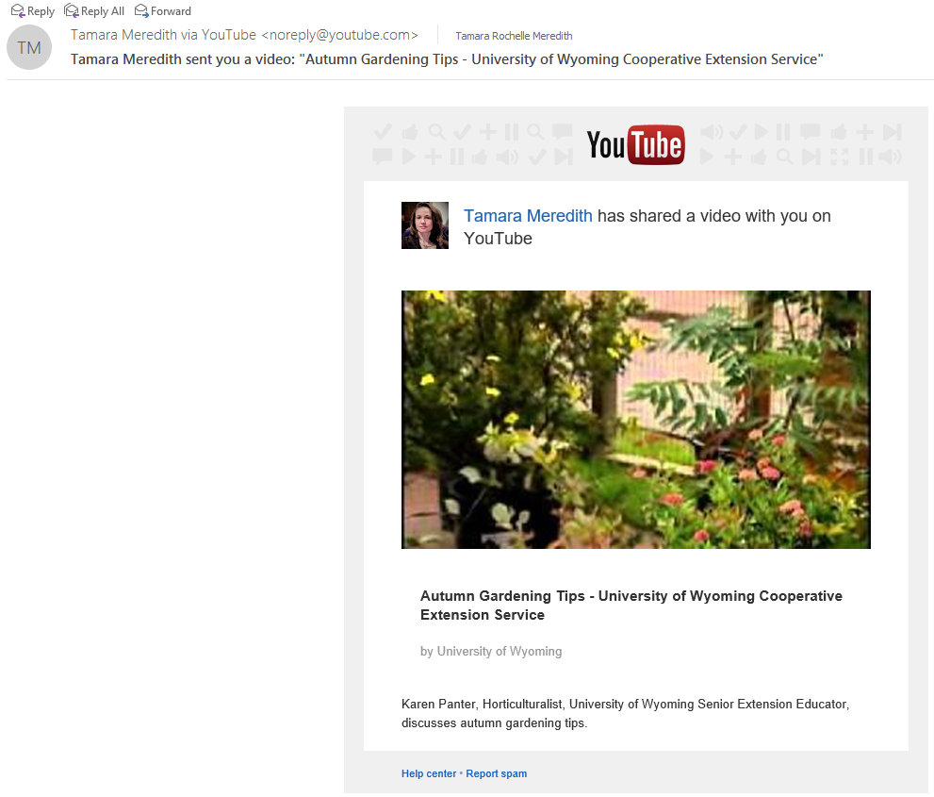
Sharing YouTube Videos
If you are logged in to an account tied to your UW email, you can use the “Email” option to send a link
Click “Share” for sharing options
Copy the URL to send the link to others

Slide 8
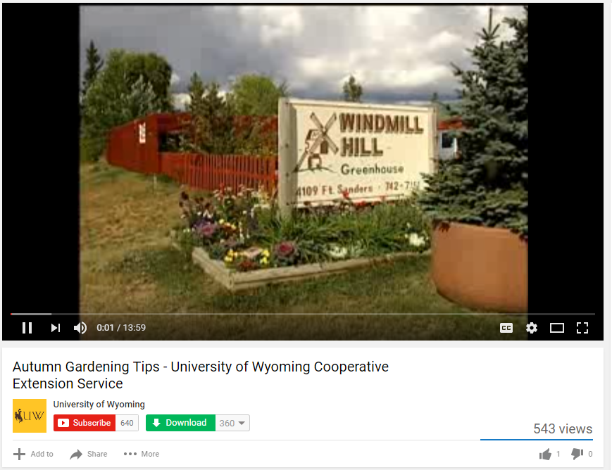
Downloading videos from YouTube
Savefrom.net
Can use online by copying URL and pasting at:
http://en.savefrom.net/1-how-to-download-youtube-video/
Can install browser extension - will be given option to download any video you encounter
Directions in Zendesk - https://uwextension.zendesk.com/hc/en-us/articles/218366983-Saving-YouTube-Videos

Slide 9
Activity
Get credit toward your “Tech-spert” badge!
Create a YouTube account (Google account) and upload a video
OR
Use Savefrom.net to download a video to your computer
When you have finished, go to this Google form and fill it out to receive credit:
http://tinyurl.com/10thingsFebruary

Slide 10
Questions?
Tamara Meredith, tamara.meredith@uwyo.edu

