Slide 1
Collaborating with Google Docs
T. Meredith, UWE Ed Tech Specialist
March 28, 2017

Slide 2
Creating a Google Account
Note: you do not need a Gmail address – you can use your work email “@uwyo.edu” to create a Google account. Enter it into the “Your email address” field.
Once you have created a Google account and logged in, you will see several options including a grid in the upper right-hand corner.
Click on the 3x3 grid to access Google tools, including Google Docs

Slide 3
Creating a New Google Doc

Slide 4
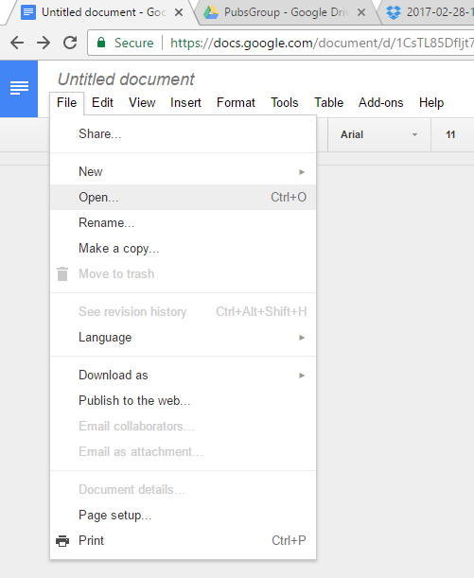
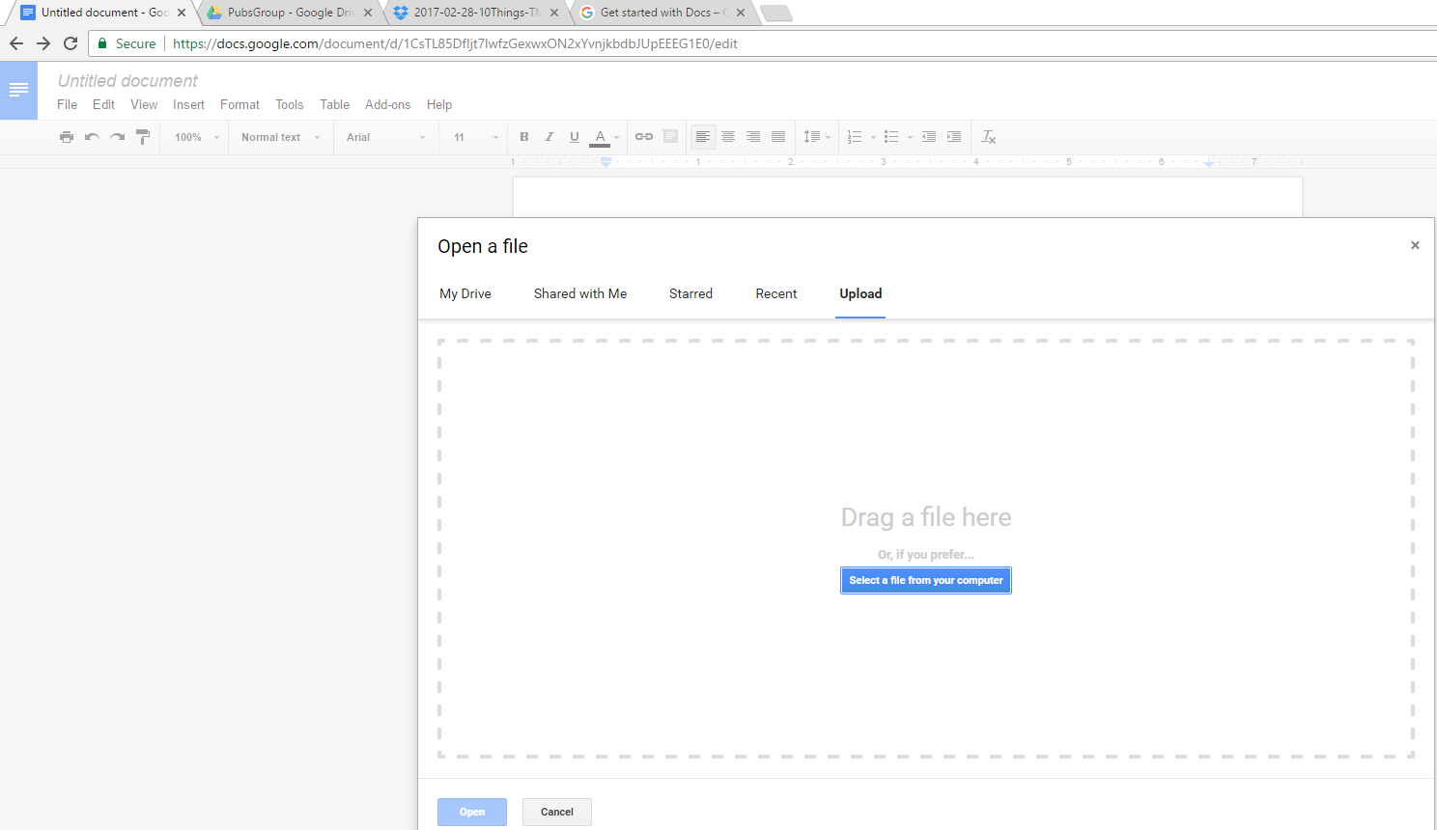
Importing Word or Other File Types

Slide 5
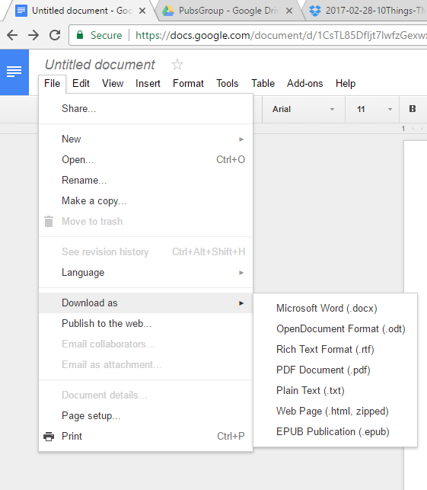
Saving as Word, PDF, or other

Slide 6
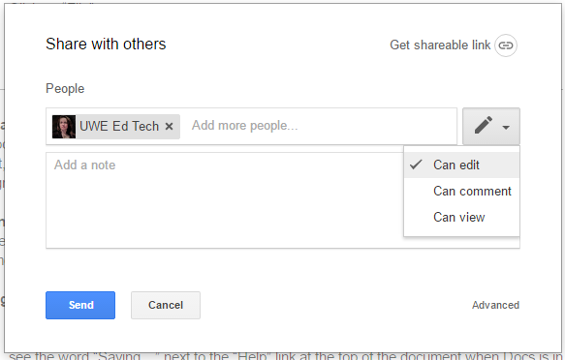
Sharing Google Docs
or

Slide 7
Collaborative Writing/Editing in Google Docs
https://docs.google.com/document/d/1zRunGwOJA3zP-MR2GUl4wrd-0speF8u9bYKCVaMwg0U/edit?usp=sharing

Slide 8
Activity
Get credit toward your “Tech-spert” badge!
Create a Google Doc and download it as a Word Document
OR
Work collaboratively on a Google Doc with another person
When you have finished, go to this Google form and fill it out to receive credit:
http://tinyurl.com/10thingsMarch

Slide 9
Questions?
Tamara Meredith, tamara.meredith@uwyo.edu

