Slide 1
Simple Photo Editing with Pixlr
T. Meredith, UWE Ed Tech Specialist
May 23, 2017

Slide 2
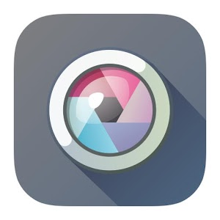
What is Pixlr?
Pixlr is a “family of photo editing apps”
Pixlr.com – online photo editing tools
Pixlr mobile apps – iOS and Android
Pixlr plug-in for Google Chrome browser
Until April 2017, owned/managed by Autodesk
Now, owned by 123RF (some changes still occurring on website…)

Slide 3
Pixlr.com - Editor vs. Express
Pixlr Editor
Pixlr Express

Slide 4
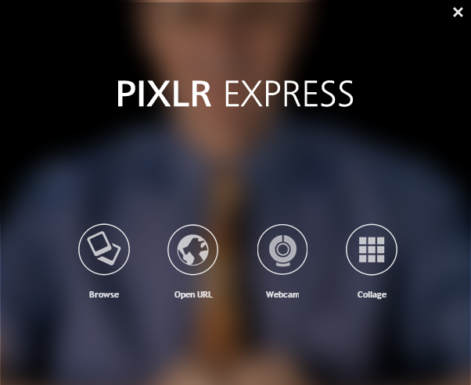
Pixlr Express – Getting Started
Choose an image from the web
Take a picture with your webcam
Use an image saved to your computer
Create a collage with multiple images (from your computer)

Slide 5
Pixlr Express - Editing Tools
Apply filters, creative layouts (think Instagram)
Add stickers/fun images
Crop, resize, autofix, sharpen, red eye, smooth, heal, rotate, etc.
Add text
Embed/overlay patterns, textures, and other images onto picture
Add a border/corner effect

Slide 6
Example

Slide 7
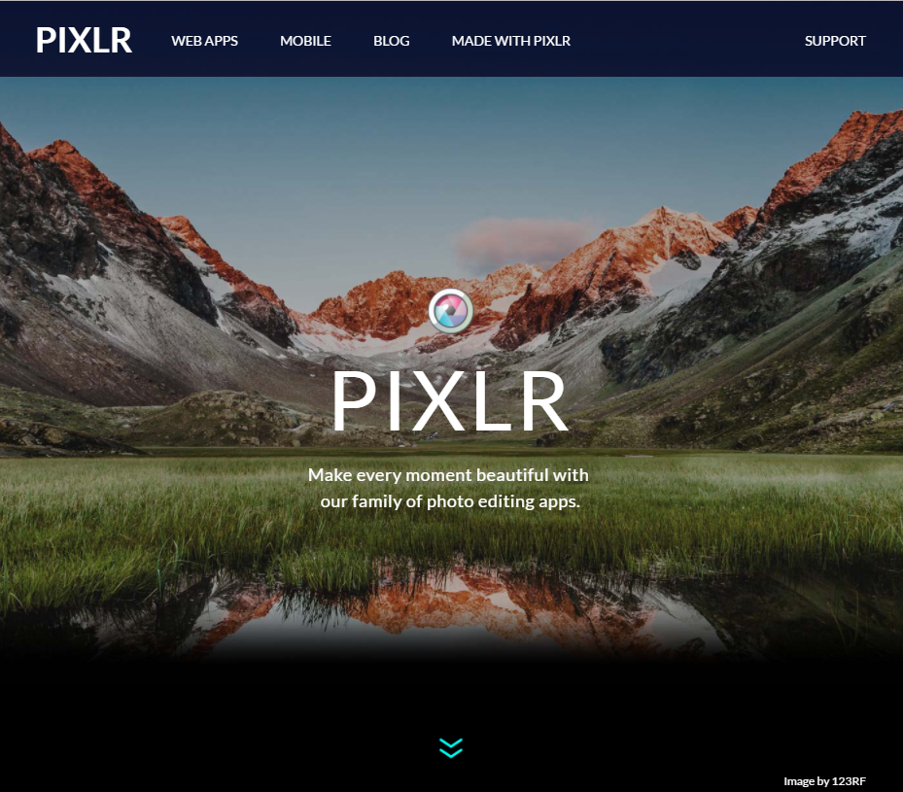
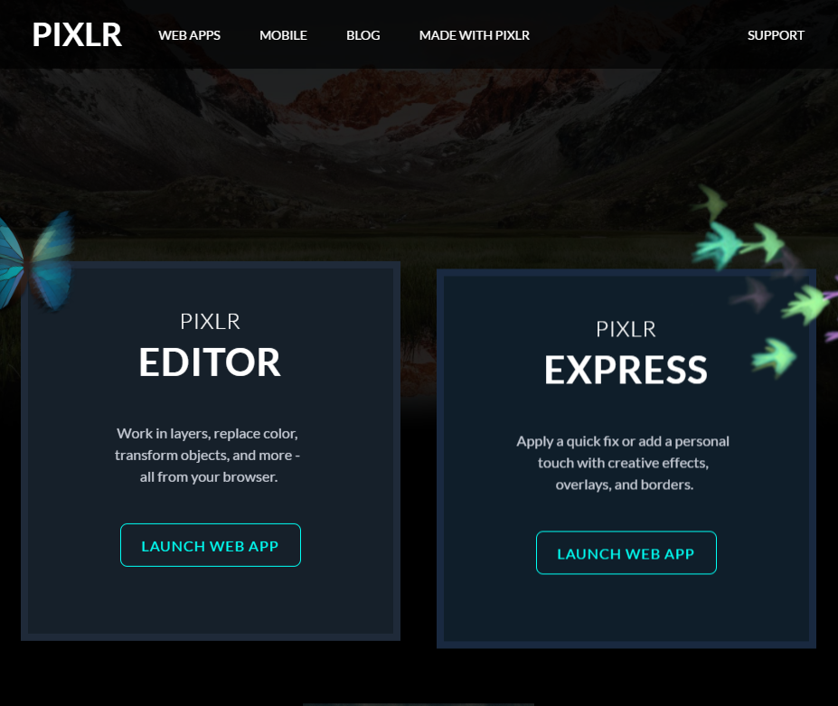
Try it out!
Go to: Pixlr.com

Slide 8
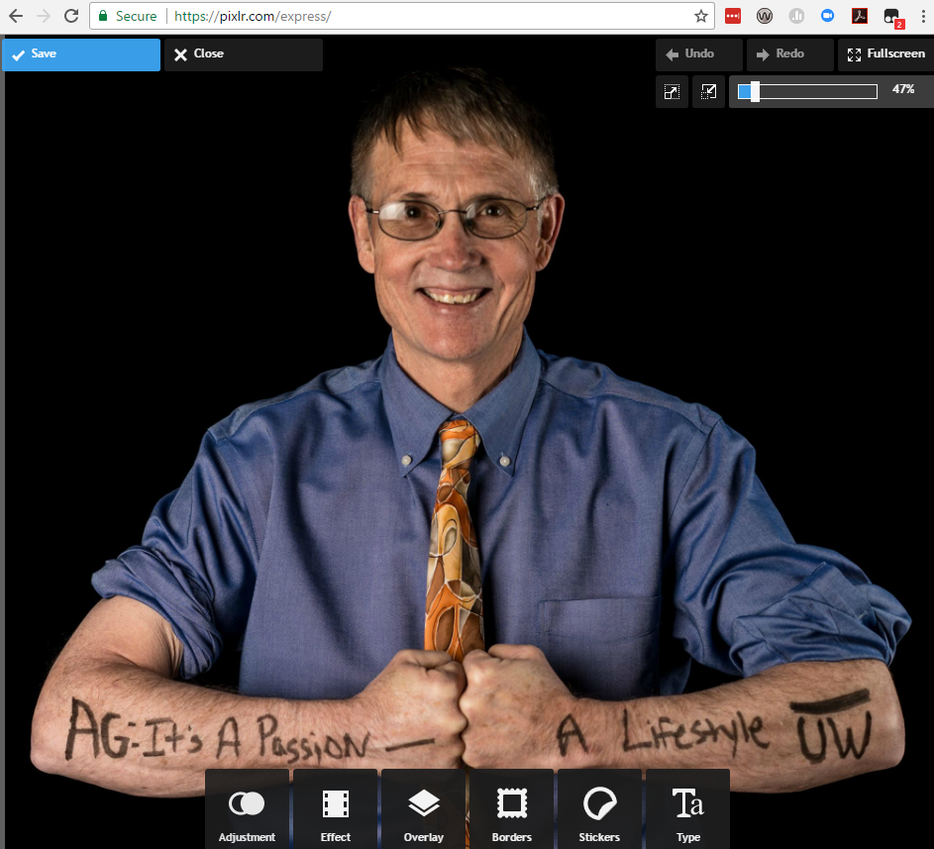
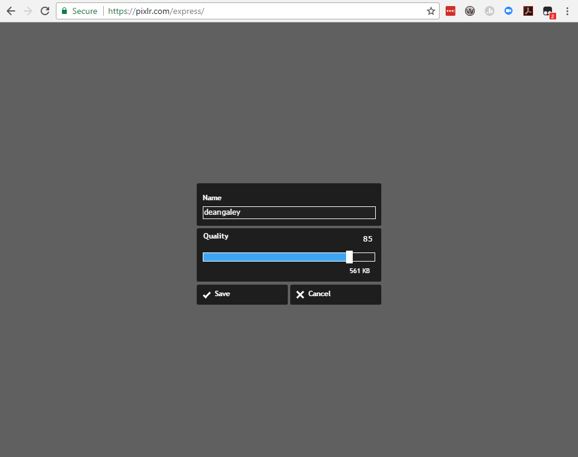
Saving Pixlr Images
Improve/reduce image quality

Slide 9
Activity
Get credit toward your “Tech-spert” badge!
Use Pixlr Express to edit an image or create a collage
OR
Download and try the Pixlr mobile app
When you have finished, go to this Google form and fill it out to receive credit:
http://tinyurl.com/10thingsMay

Slide 10
Questions?
Tamara Meredith, tamara.meredith@uwyo.edu

