Slide 1
Safety & Security Online
T. Meredith, UWE Ed Tech Specialist
September 26, 2017

Slide 2
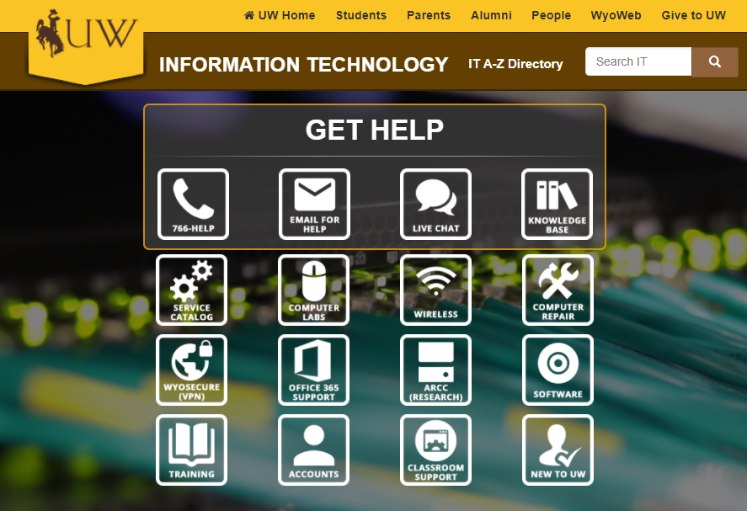
What UW provides...
Email filters for spam/phishing attempts
Webroot or Windows Defender anti-virus software (free for UW-owned computers)
Recommendations for anti-virus software (personal computers)
Software for erasing computer hard drives
Online training course on phishing & identity theft

Slide 3
Finding good resources
For work:
UW IT – Knowledge Base (use search tool)
Online Training (45-60 minutes, certificate of completion)
For personal use:
Consumer.FTC.gov (identity theft, protecting kids, etc.)
Stopthinkconnect.org (multiple languages available)

Slide 4
Contacting IT with questions...
Use the “Technology in UWE” page to determine who/how to contact
Go to “Employee Resources”
Click on “Technology in UWE”

Slide 5
Activity
Get credit toward your “Tech-spert” badge!
Watch/re-watch the training video “Identifying Phishing Emails” at https://www.youtube.com/watch?v=PAtOHSfKZoo
OR
Complete the online course (45-60 minutes) at: https://uwittraining.catalog.instructure.com/courses/identy-avoid-phishing
When you have finished, go to this Google form and fill it out to receive credit:
http://tinyurl.com/10thingsSeptember

Slide 6
Questions?
Tamara Meredith, tamara.meredith@uwyo.edu

