Slide 1
Filing the annual
Form 990-N
for all
4-H bank accounts

Slide 2
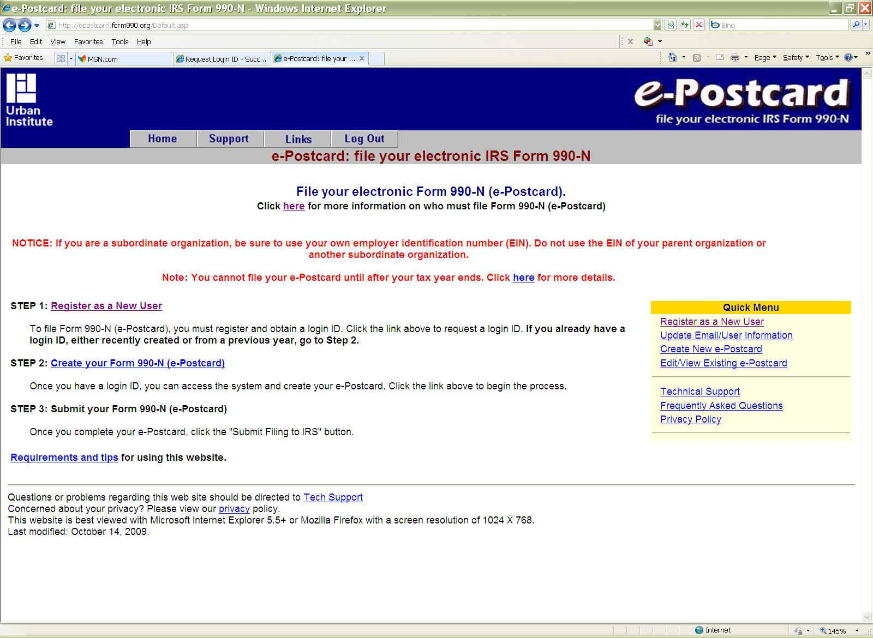
Go to:
http://epostcard.form990.org

Slide 3
Click on STEP 1

Slide 4
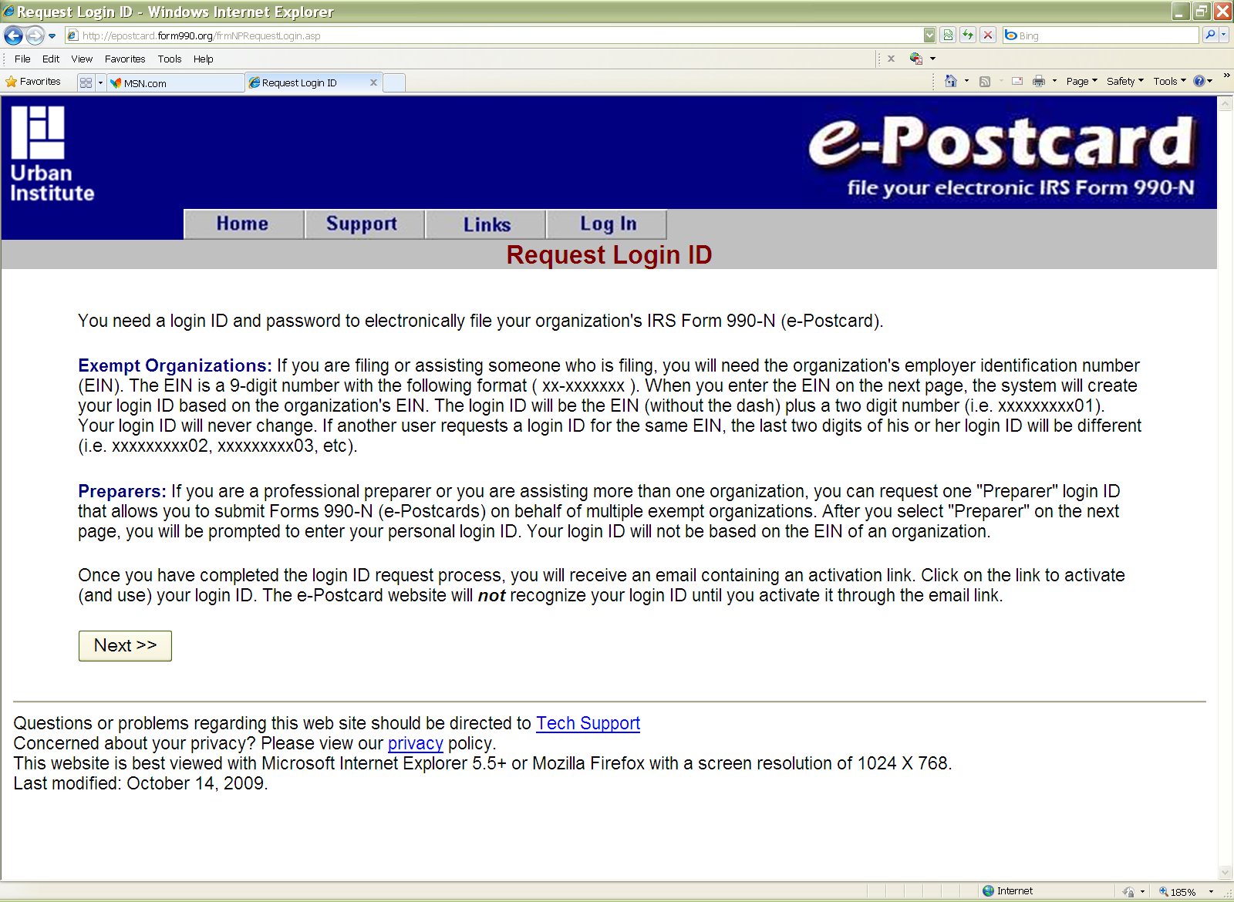
You will need to file each club separately. File as an Exempt Organization not as a Preparer.
Click on “Next”

Slide 5
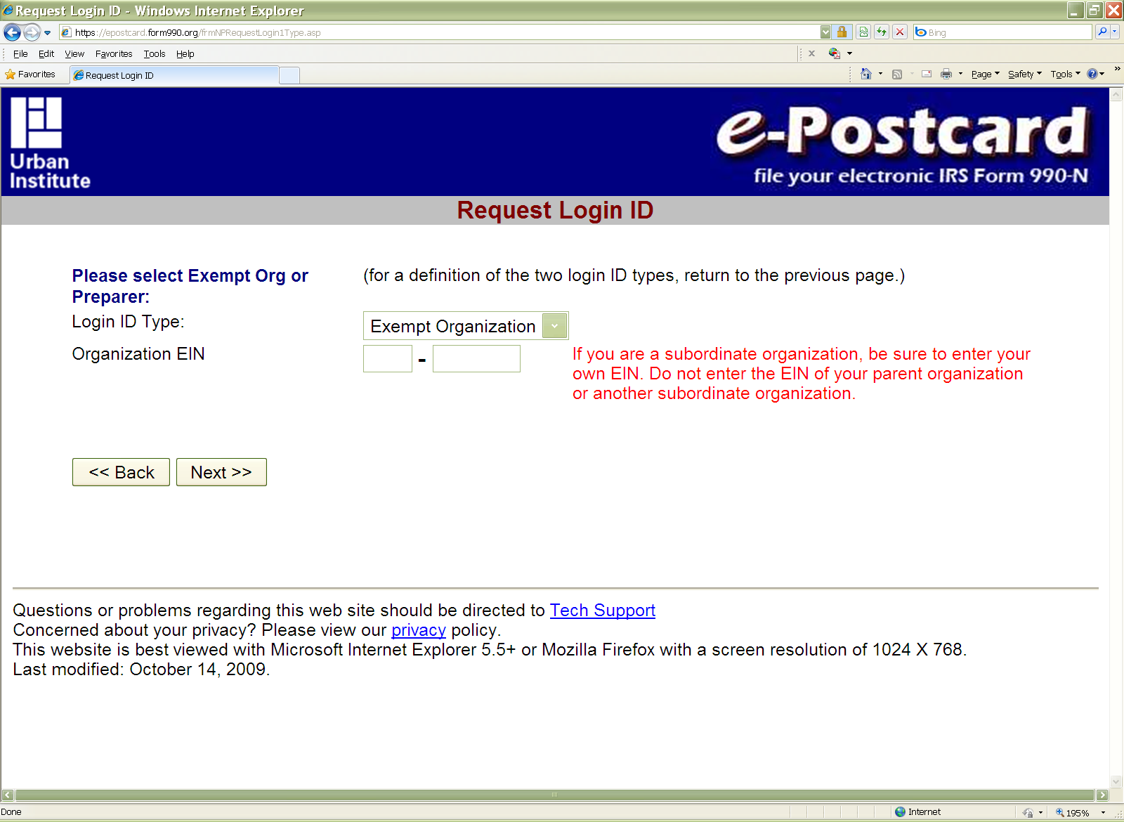
Login in type will be: Exempt Organization
Enter a club’s EIN number
Enter the club’s or group’s EIN
Click on “Next”

Slide 6
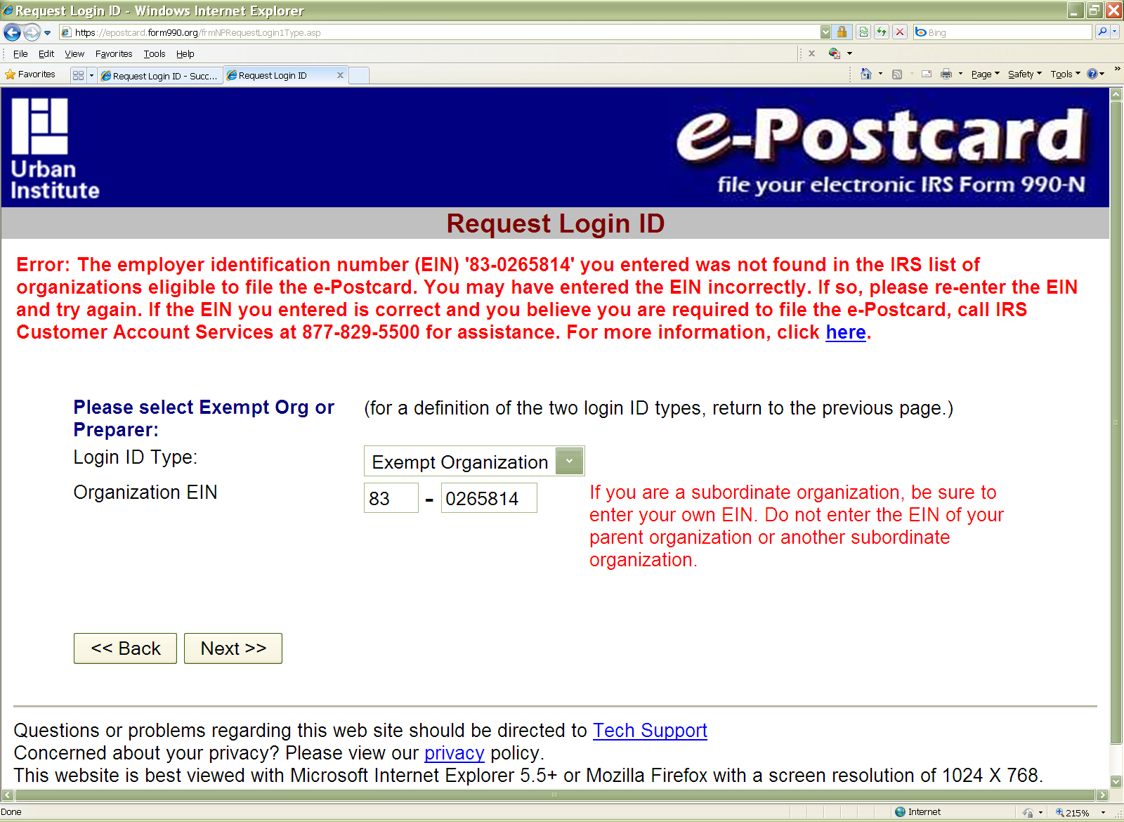
If your club’s EIN number is not linked to the National 4-H Group Exemption Number (GEN), this is the response you will see this:
Please print this page and save in your files for this club. You could put a copy of it with other chartering financial records.

Slide 7
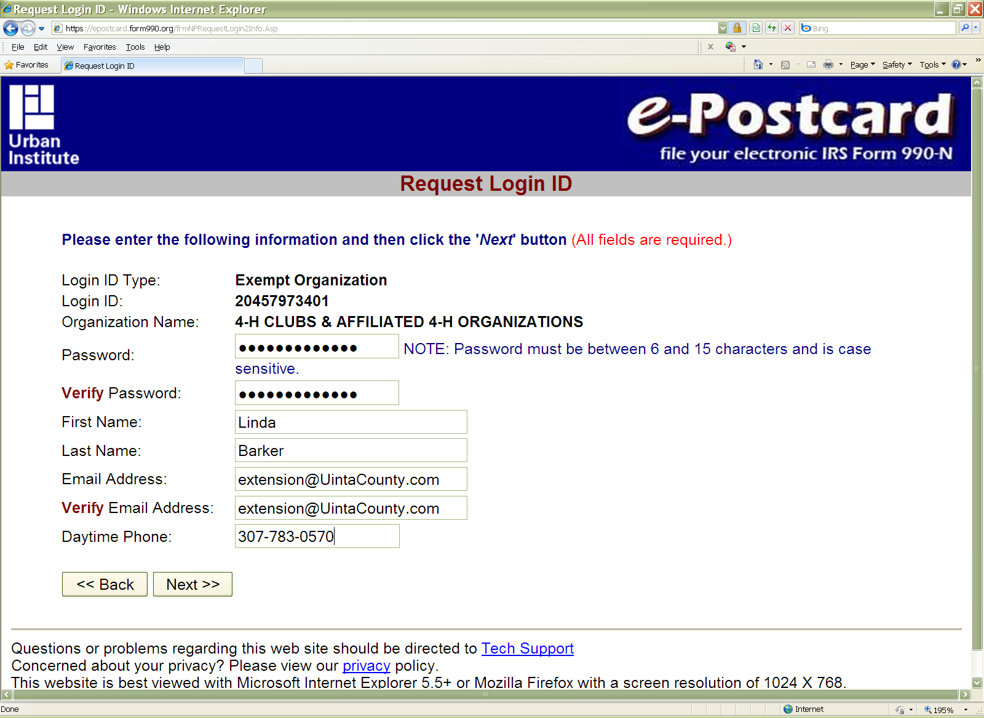
If your club’s EIN number is linked to the National 4-H Group Exemption Number (GEN), this is the response you will see requesting more information:
Enter the 4-H Educator’s name
Enter an e-mail address which you can easily access.
Click on “Next”

Slide 8
You should see this screen. It will ask you to activate your login via e-mail
Go check the email address you provided earlier.

Slide 9
Example email indicating that club’s Login ID and directing you to activate it.
The following is your e-Postcard login ID:
Login ID: 26006612101
Name: Kendra Myers
Organization: 4-H CLUBS & AFFILIATED 4-H ORGANIZATIONS Login Type: Exempt Org
Click the link below to activate your login ID. (Note if your email program does not display the web page as a link, copy the whole link and paste it into your browser.)
IMPORTANT: You should close any open browser windows before you click this link.
https://epostcard.form990.org/frmAdminLoginActivate.asp?A=X317894v838797qBv
Contact technical support if you have any questions
e-Postcard Technical Support Team
email: epostcard@urban.org
Phone (toll free): 866-255-0654

Slide 10
The link within the e-mail will take you to this screen to activate your login.
Enter password

Slide 11
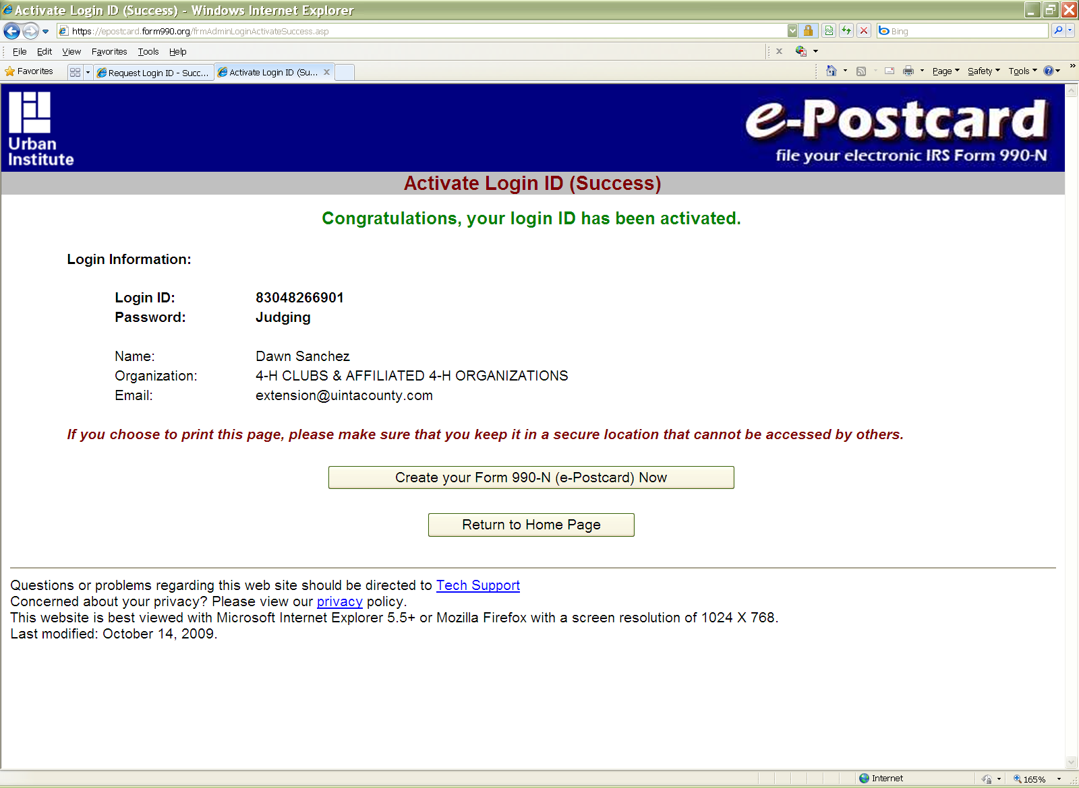
After completing login in steps – this screen will show the login in & password for this club.
Please print this page and save in your files for this club as it is the only record you’ll have of the club’s Login ID and password information for ease in filing next year.

Slide 12
You’ve finished Step 1.
The ID you created will be used next year for that club and EIN. In the future, you won’t have to do Step 1 again for any renewing clubs, but you will for each new club.
Now to the E-postcard itself….

Slide 13
Click here

Slide 14
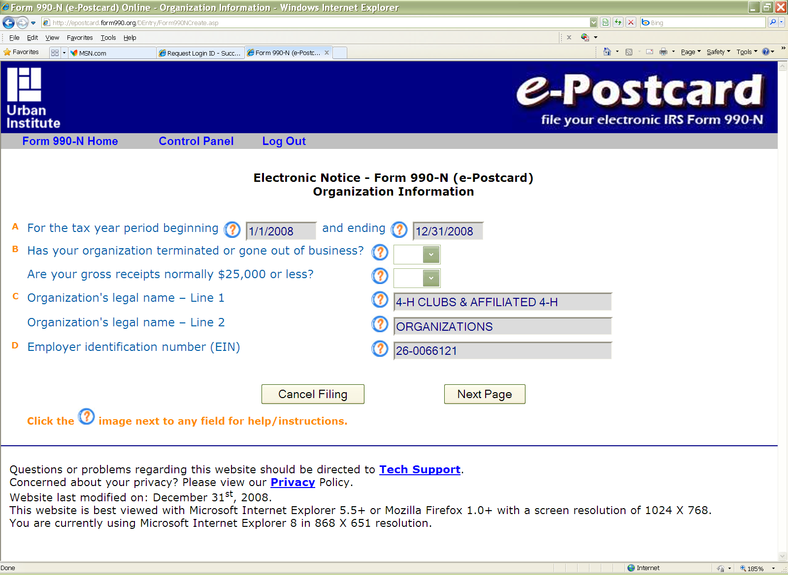
A. In future this will match our 4-H year dates. For now, leave as is.
B. Enter No
B. Enter Yes
C. Leave as they are.
Click here

Slide 15
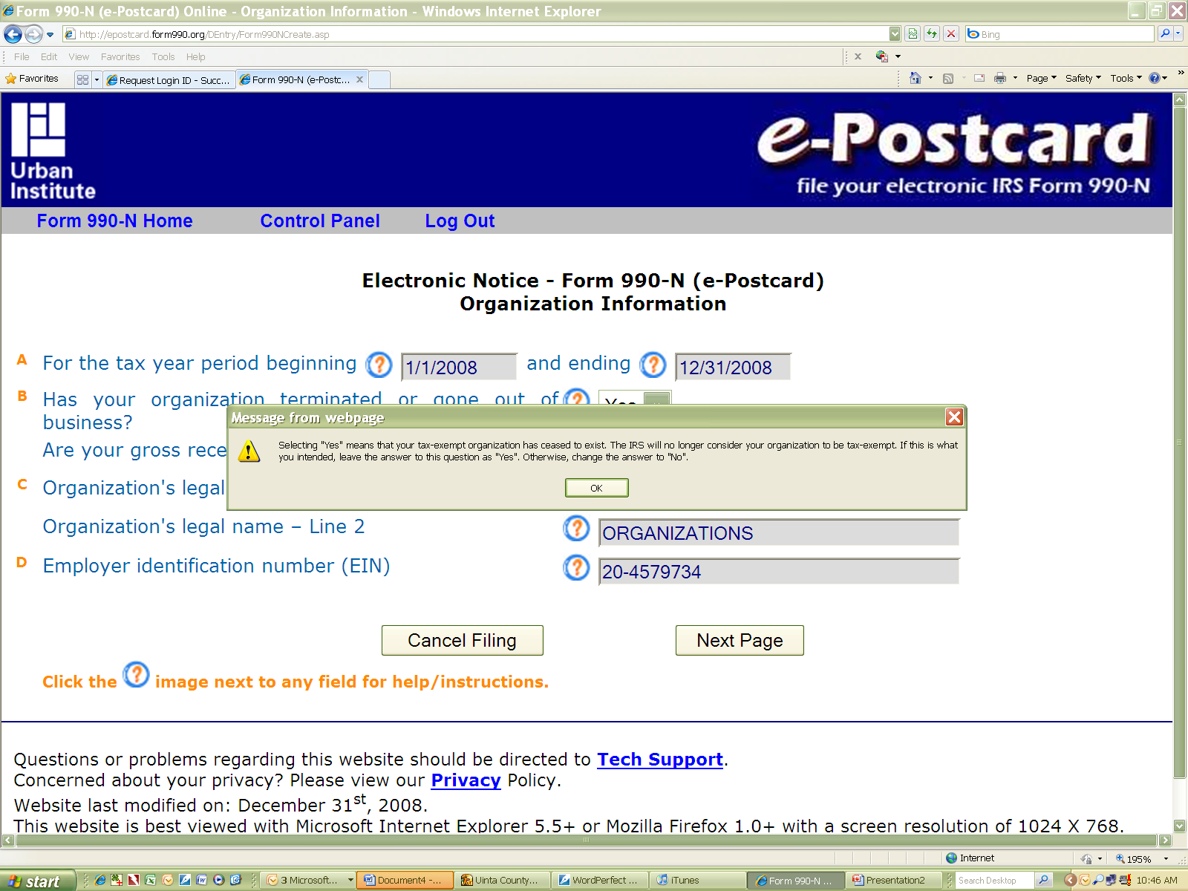
If the club/bank account has gross receipts of more than $25,000 this is NOT the correct IRS form to use. Each of those clubs/accounts has to file a Form 990 EZ or long Form 990 each year.

Slide 16
If no problems,
the next page you should see is this one…
Enter Club’s Name
Leave blank
CES Office Address
Leave blank
Click here
Click here
Select “Person”
4-H County Educator and CES office address

Slide 17
After entering the required information and clicking submit and it will take you to this screen
You can log out and you’ll get an email or you can go to the status page . On status page…

Slide 18
From here you can view and print the actual Epostcard by clicking here.

Slide 19
Epostcard for a club/bank account.
You can print this an keep on file if you like.

Slide 20
E-Mail showing acceptance.
-----Original Message-----
From: epostcard@urban.org [mailto:epostcard@urban.org]
Sent: Thursday, December 10, 2009 10:47 AM
To: 4-H@UintaCounty.com
Subject: Form 990-N E-filing Receipt - IRS Status: Accepted
Organization: 4-H CLUBS & AFFILIATED 4-H ORGANIZATIONS
EIN: 26-0066121
Submission Type: Form 990-N
Year: 2008
Submission ID: 7800582009344az69180
e-File Postmark: 12/10/2009 12:40:50 PM
Accepted Date: 12/10/2009
The IRS has accepted the e-Postcard described above. Please save this receipt for your records.
Thank you for filing.
-------------------------------------------------------------------------
e-Postcard technical support
Phone: 866-255-0654 (toll free)
email:ePostcard@urban.org
-------------------------------------------------------------------------
4-H CLUBS & AFFILIATED 4-H
ORGANIZATIONS
228 9th Street
Evanston, WY 82930
Please print all such emails and save in your files for this club. You could put a copy of it with other chartering financial records.

Slide 21
If you have any questions, feel free to contact Johnathan at the State 4-H Office.
**Thanks to Uinta County staff for providing
screen shots and testing. **

