Slide 1
Welcome to Wyoming 4-H
New Leader Orientation
Notes:
Thank you very much for joining us today. The Wyoming 4-H program serves over 7000 youth in 23 counties and one reservation. We do have staff in every county, but the only way we can be successful is through dedicated volunteers who work with our youth, helping them to grow and develop in the 4-H program.

Slide 2
4-H Volunteer training
To learn more about 4-H and your role as a volunteer
To strengthen your understanding of how to work with youth through 4-H
To encourage safe practices for 4-H youth and adult volunteers
Notes:
Today’s training will not cover how to be a 4-H club leader or a 4-H project leader. As part of today’s training, you will learn more about the 4-H program and the role you can play as a volunteer. You will strengthen your understanding of how to work with youth through 4-H. And we will finish the training by sharing the safe practices that should be used when working with youth and other adult volunteers. We do have additional trainings or materials available to help with specific roles in the 4-H program. If you want additional information after the training please feel free to ask me more about a specific role or subject matter.

Slide 3
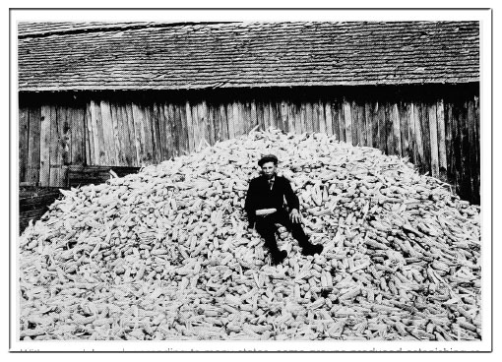
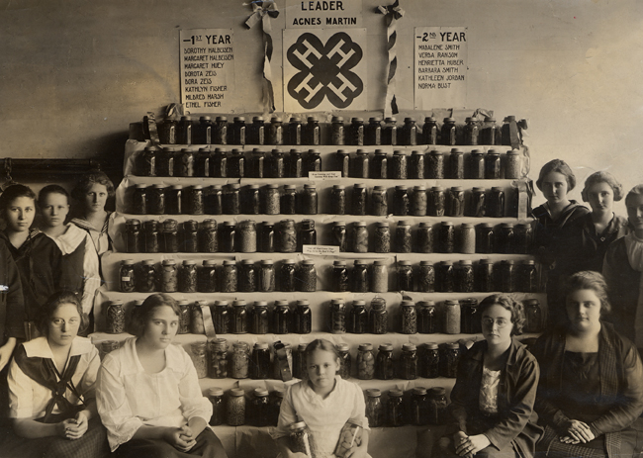
4-H history
Notes:
4-H is not a new organization. 4-H has been an active part of American society since 1902. 4-H was started when Extension Agents were trying to share new ideas in growing corn with farmers. Farmers were apprehensive to try something new and Extension Agents met resistance. In order to continue their education efforts the Extension Agent used boys to start new corn crops with the results being corn yield that were much higher than that of traditional methods their fathers were using. The photo on the right are the beginnings of 4-H showing boys taking pictures with their bountiful corn yields. Corn clubs for boys and canning clubs for girls were the start of 4-H in the United States.
Let’s watch a video that complete the history of 4-H and brings us to present day 4-H in America.
This following video has a great summary of where we started to where we have come. https://www.youtube.com/watch?v=4vJ5Ab-uTDk

Slide 5
4-H Today
What are the top 5 projects in Wyoming 4-H?
Rifle with 1484 youth enrolled
Swine with 1361 youth enrolled
Archery with 1200 youth enrolled
Beef with 1094 youth enrolled
Sheep with 994 youth enrolled
Notes:
The good news is that 4-H today offers projects beyond growing corn and canning tomatoes. 4-H is working to reach the needs of youth throughout Wyoming and the United States. In 4-H we offer projects in agricultures, family science, arts, technology, and so much more. Can you guess the top projects in the Wyoming 4-H program? You may be surprised that the top project is not related to agriculture.
*Feel free to change these to county stats.

Slide 6
Local, state, and national scene
Local
-Members, Volunteers, Parents, 4-H Educator, County 4-H Committees, County Commissioners
State
State Program Coordinator, State Specialist, Director of Extension, University President, Legislators, and the Wyoming 4-H Foundation
National
USDA, United States Congress
Notes:
Most of us are familiar with our local 4-H club or county program, but 4-H is much bigger than that. In addition to your club at the local level 4-H is impacted by County Commissioners who help to fund the 4-H program in the county. The county program is guided by your 4-H Educator who receive feedback and ideas from 4-H County Committees.
At the State Level, the State 4-H Office works to develop trainings and opportunities for volunteers and members. 4-H is part of the University of Wyoming Extension System which means the Extension Director and the University President are also part of the 4-H program. In addition we receive state funding so we rely on the support of the Wyoming Legislature and the Wyoming 4-H Foundation to help fund the 4-H program.
4-H reaches all of the way to the National Level. The National 4-H Staff are part of the USDA and funding for 4-H is part of legislation made by the United State Congress.

Slide 7
Funding partnership
State
Federal
County
Notes:
The 4-H program is supported by a unique blend of tax funds (county, state, and federal) and private donations. State and federal tax funds are used to help pay extension staff salaries and to provide educational materials. County money supports the operation of local extension offices.
Our unique set of funding sources also mean that we must meet a unique set of requirements. The 4-H program may require you to answer questions, follow policies, and fill out paperwork that is not like other organizations. The model above is part of the reason why this happens.
Our funding also means that programming is different by state and county. If you move to a county program, even if both counties are in Wyoming, you may find that business is conducted a little different in each county. You will want to check with your 4-H Educator if you have questions about confusing or differing procedures related to 4-H programming efforts.

Slide 8
Affirmative Action
Persons seeking admission, employment, or access to programs of the University of Wyoming shall be considered without regard to race, color, religion, sex, national origin, disability, age, political belief, veteran status, sexual orientation, and marital or familial status. Persons with disabilities who require alternative means for communication or program information (Braille, large print, audiotape, etc.) should contact their local UW Extension Office.
Notes:
Since UW Extension receives federal funding we must follow the UW Affirmative Action plan. This ensures that all 4-H members and volunteers are treated equal regardless of their race, color, religion, sex, national origin, disability, age, veteran status, sexual orientation, or political belief. You may notice a disclaimer statement on documents created by any UW entity. In 4-H we make every reasonable accommodation to help youth and adults participate in our programs.
In addition we are required to follow policies of the University of Wyoming. One of those policies when working with youth is that volunteers receive training. This is one of the reasons we ask that all new volunteers participate in the New Leader Training.

Slide 9
The Wyoming 4-H Picture
Mission:
To empower youth to reach their full potential by working and learning in partnership with caring adults.
Notes:
The Wyoming 4-H polices outline specific for the delivery of the Wyoming 4-H program. The policy documents start out by sharing the mission, vision, and values of the program. The work that we do in 4-H is all about helping youth to reach their full potential by working and learning in partnership with caring adults. This mission statement makes your role as a 4-H volunteer very important. Without you we would not be able to carry out a core piece of our mission statement.
When doing this we use the PYD philosophy. Does anyone know what PYD stands for?

Slide 10
Recognize and utilize youth strengths.
Provides a environment for positive learning experiences.
Fosters positive relationships with caring adults and other youth.
Supports youths need to build their leadership skills.
Provides a safe environment for youth to take risks.
ositive
outh
evelopment
Notes:
PYD stands for positive youth development.
In your folder you will find out a handout that addresses the ins and outs of PYD.
Highliths of PYD include:
A program that Recognize and utilize youth strengths.
A program that Provides a environment for positive learning experiences.
A program that Fosters positive relationships with caring adults and other youth.
A program Supports youths need to build their leadership skills.
And a program Provides a safe environment for youth to take risks.
As you work with youth in the 4-H program remember that the principles of PYD should be part of your program planning and implementation.

Slide 11
The Wyoming 4-H PYD Picture
THE YOUTH EXPERIENCE
As a member of the Wyoming 4-H Program, we look to provide the following experiences to youth:
The opportunity to set goals, keep records, and reflect on their learning in a project area.
A caring adult to provide the support needed to develop life skills through project work.
Opportunities for hands-on learning experiences.
A place to publicly display their learning in one or more project areas.
Opportunities to use the skills learned in their club and project work at a county, regional, state, national, and international level.
Notes:
In addition to the mission, vision, and values, the policy documents outline what the youth experience is related to the 4-H program. No matter what projects youth are enrolled in or how they choose to participate in the 4-H program as a volunteer you help us to make sure that youth in the 4-H program are able to set goals, keep records, and reflect on their learning in a project area. You serve as a caring adult who provides the support needed to develop like skills through project work. You can help us in providing and planning opportunities for hands-on learning experiences.
The fair and other similar experience give you a place to publicly display their learning in one or more project areas. And we hope that you understand, and help youth and their families to understand that 4-H is a very broad organization. This gives youth the opportunity to use the skills learned in their club and project work at a county, regional, state, national, and international level.

Slide 12
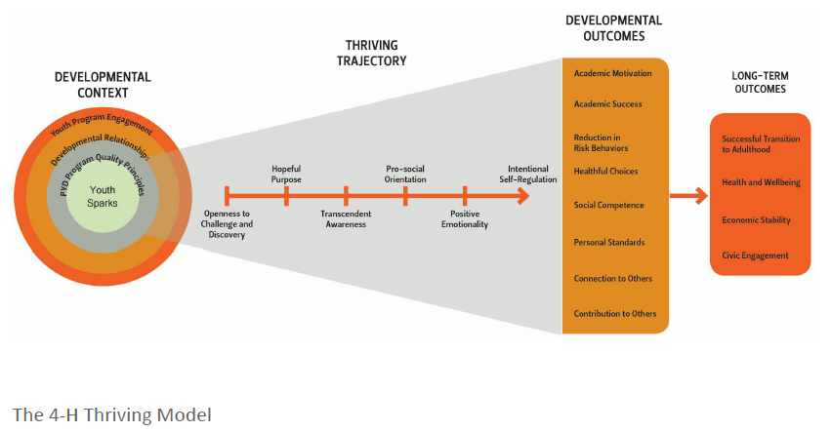
The Wyoming 4-H PYD Picture
Notes:
4-H is based on a positive youth development (PYD) approach that recognizes all youth have interests, abilities, and strengths that can be enhanced by participation in 4-H programs. Research shows that participation in high quality 4-H programs increases thriving in youth, and thriving youth achieve important develop-mental outcomes, such as academic motivation and achievement. The thrive trajectory starts with the youth spark (or interest) that gets them excited to learn. We (adults) then set the stage to make sure the learning environment is positive and engaging through encouragement and a “push” when needed.

Slide 13
PYD starts with a “spark”
Getting them “hooked”
Project Skills
Woodworking – measuring, sawing a straight line, sanding, applying finish
Clothing – Cut a pattern, lay out material, threading a machine.
Notes:
Most of you are familiar with 4-H projects. Youth usually join 4-H because of an interest they have in a particular subject area like beef, visual arts, or archery. The skills they learn through project work are called project or activity skills. Learning these type of skills are the hook or reason that youth get involved in 4-H. Examples of this in woodworking might be measuring, sawing a straight line, sanding, or applying finish. Similarly in clothing Cutting a pattern, laying out material, or threading a machine.

Slide 14
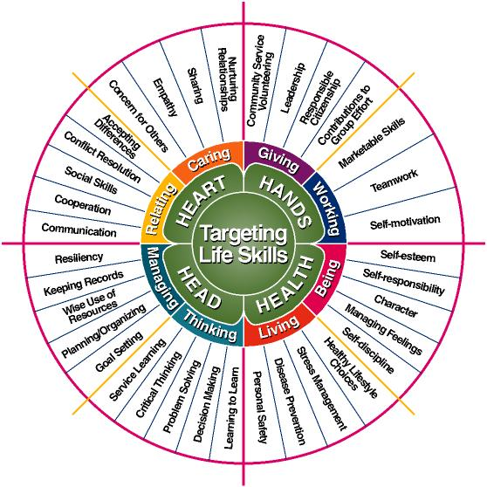
Targeting Life Skills Model
Notes:
While project skills are the spark and learning tool for 4-H members our ultimate goal is the development of life long skills. Skills that members can use well beyond their years in the 4-H program. Iowa State created this helpful model that breaks some of these skills into four categories, head, heart hands and health. These are not the only life skills that exist, but it is a good starting point. As you work to plan 4-H activities keep in mind that life skill development should be an integral part of your program delivery.
In your folder you will find a handout that includes more about life skills and a large copy of this model to help you keep life skill development in mind.

Slide 15
Experiential Learning Model
Notes:
The 4-H experience is about learning. As a 4-H volunteer you can enhance the learning experience by using the experiential learning model. In 4-H we are very good at providing youth with the 1st level of the model, the experience, in fact we are so good our motto is learning by doing. However, often we stop there are forget to help member related their learning experiences to real life situations. As members learn in your projects and activities think of ways to provide opportunities for them to work through the model by sharing, processing, generalizing, and then applying.
This can often be a confusing process. The handout you have been provided has some targeted questions you can ask members to help move them through the learning model steps. Some of the questions are more complicated and some are simple. Use this as a reference of how to help 4-H members expand their learning in 4-H.

Slide 16
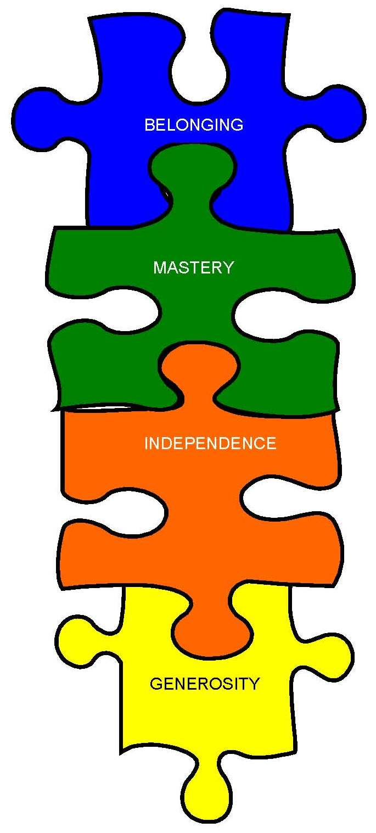
Creating the environment for PYD: 4 Essential Elements
Independence
Belonging
Generosity
Mastery
Notes:
As a 4-H volunteer you are responsible for helping to set the stage for member to have a positive 4-H learning experience. Research shows that there are four essential elements that are needed in a youth organization to promote positive youth development. In the 4-H program we call these the four essential elements.
Belonging, this element is fostered by
By providing an inclusive environment that includes social interaction between youth with diverse backgrounds
By contributing to team efforts
By developing positive relationships with a caring adults
Independence happens
By supporting self-directed decision making process that relates to real-life experiences
By fostering leadership opportunities
Generosity occurs
Through involvement in civic engagement activities
Through opportunities to share experiences with younger youth members
and Mastery
Through development of specific knowledge and skills with help and guidance from project leaders
Through opportunities to learn how to run effective meetings
Through understanding of finances gained through access to funds raised by the club
As you work as a 4-H volunteer consider these essential elements in your planning and learning experiences. In your folder you will find a handout describing each element and how to incorporate it into 4-H experiences.

Slide 17
Curriculum Here to Help!
Latest Research Based Knowledge
Hand On
Do Reflect Apply
Generosity, Mastery
Life Skill Related
Notes:
WOW! Essential Elements, Experiential Learning, Project Skills, and Life Skills is a lot to think about as you plan activities for 4-H. Don’t worry the good news is we have you covered. Each 4-H project that is offered in Wyoming has curriculum or learning books that address all of this. The curriculum is based on the most recent research, at least as best it can. If you look at the leathercraft curriculum it is from the 1970, but it is still relevant. In addition most of the curriculum has hands on experiences, has ways to incorporate the experiential learning model into learning, gives examples for youth to practice generosity and mastery, and looks specifically at life skill development.
In your folder you will find a complete list of projects offered in Wyoming and the name of the specific curriculum offered for that project. The county extension office should have complete set of the curriculum listed and most curriculum can be purchased for $5 or less. This curriculum list is also a great way for us to serve youth in projects that do not have leaders. Most of the books are a great way for youth to complete their own self guided project study if a caring certified volunteer is not available.

Slide 18
Ages and Stages
Notes:
One of the best parts of the 4-H program is that it allows youth ages 5-18 to participate in a program together. It truly helps to make 4-H a family event. One of the most challenging parts of the 4-H program is that we have youth ages 5-18 participating in a program together. When working with 4-H youth it is important to remember that. The next series of slides will look at the ages and stages of youth development and growth. Not all youth of the same age grow and develop at the same rate or speed, just like a plant. However, the sequence of development is the same for all youth - you can’t run before you walk, no matter how old you are!
Age ranges help us focus on the unique physical, cognitive, social and emotional development of youth within a similar age grouping. The ranges help us plan and provide experiences that are appropriate for different ages.
How does it work? We communicate with seven-year olds in a different way than 13 year-olds. Sixteen year olds have different social needs than 10 year olds. Five year olds don’t have the physical, cognitive and social/emotional ability to compete in a livestock contest but 14 year-olds probably do. Knowing these developmental differences will help you be better prepared to work with youth.

Slide 19
Young Childhood
Ages 5 – 7 (Cloverbuds)
Simple and clear instruction
Break tasks into manageable steps
Give rules
Focus on doing
Encourage cooperation not competition
Notes:
Remember we are talking in general terms. At this age children are concrete thinkers, which means they are literal thinkers.
➔ Give instructions that are simple and clear. Break tasks down into more manageable steps. Example – “We are going to make fruit salad. First, I want you to walk to the bathroom and wash your hands with soap and water. Use a paper towel to dry off your hands”. They are not yet able to set goals and carry out projects over a longer period of time. Clover Kids don’t do 4-H project work for this reason.
➔ Rules help them understand new environments and expectations. Alertness to rules doesn’t mean they like to follow them, but they quickly notice when others don’t. That’s why tattling is prevalent at this age! In groups, identify the rules (no talking when others are, take turns, and other rules) and consistently enforce them.
➔“Process” and “Product” – children are more interested in the process of making or doing something rather than the end product. Children like the process of making a PB&J sandwich more than eating it. They enjoy spreading peanut butter with a knife, experiencing the texture of the peanut butter and bread and putting the sandwich together. Active and hands-on experiences for this age group are very important. They need to be “doing” – whether it is making a snack, planting seeds, or playing games. Long periods of sitting and listening should not be a Clover Kid experience.
➔ Cooperation and Competition – children are not ready cognitively, socially or emotionally for competition. The maturity of dealing in a positive with winning and losing is not yet developed. Children can’t separate who they are as a person from the results of winning or losing. In their concrete thinking, “if I win, I’m a winner. If I lose I’m a loser”. Self-worth can be damaged if they are put in competitive situations. This is the reason Clover Kids are not allowed to compete. Cooperation and learning to get along with others should be encouraged.
➔ Behavior in Group Settings – children are still learning to control their bodies and themselves in group settings. Leaders can help them by first, providing hands-on activities that allow them to be busy. Second, establish clear expectations for behavior that are child friendly and engaging. Here are phrases you can use to help guide behavior:
“Dot, dot, not a lot” - this helps children limit the use of glue during art and craft activities
“If you’re within the sound of my voice clap your hands 3 times” - this helps children transition and quiet down
“One two three, eyes on me (leader says) , one two eyes on you (children says)” – this helps children transition and quiet down
“Shake out the wiggles” – this helps children release energy so that they can better focus on the activity at hand (hopefully)
Similar strategies may work for older youth as well.

Slide 20
Middle Child
8-10 Year Olds
Establish rules, they will find loop holes
Helping others encouraged
Forming friendships
Cooperative
Same sex preferred
Notes:
At this age your 4-H’ers can begin to set goals and carry out projects over a longer period of time. They also have increased language ability to express their thoughts and feelings. Arguments and conflicts are now more likely to be verbal than physical.
➔ Emerging ability to set goals – 4-H project work begins in this age group because 8-10 year-olds can begin to set goals and carry out projects over a longer period of time. Their eagerness to learn new skills and try new things makes project work a great way to satisfy this need.
➔ Rules –Once rules are generally understood, the next step in development is to begin questioning them. Enter 8-10 year-olds! They are terrific loop hole detectors! Beware!
Older youth in clubs or project meetings can help younger ones understand and follow rules.
➔ Friendships –Youth have a heightened need to form friendships and be a part of a group. Forming and keeping friends requires very complex skills such as the ability to listen, support, communicate, get along. This age range still needs lots of help in developing these skills. Remember that the social part of the 4-H program is just as important to foster as project work, community service, citizenship and character. You might encourage older youth in your group to be a mentor or friend to younger ones.
➔ Cooperative – youth this age are generally cooperative and want to please adults. They are also easily motivated and eager to try new things.
➔Same Sex – At this age they prefer to be with kids of their sex. Keep this in mind when you are planning activities. At the same time they really admire and imitate older boys and girls so this is a good time to have older, same sex club members help with projects and activities.
➔

Slide 21
Early Adolescence
Youth ages 11-13
Rules, love to test them, maybe break them
Fitting in is important
Self-Conscious
Invincible
The world is my stage
Attitude
Notes:
At this age youth are moving toward more abstract thinking. They have better problem solving abilities, can imagine multiple possibilities and take on more responsibilities. 4-H volunteers should provide them with opportunities for input, leadership and planning 4-H activities and experiences. Sometimes, with increased cognitive and communication skills, comes the ability to argue more – mainly with parents!
➔ Rules – they change for this age group compared to younger youth. Five to seven-year olds are rule bound. Eight to ten year-olds begin to question rules. Eleven to thirteen year-olds now begin to test and break the rules.
Friendships – “fitting” in is very important. The “right” clothes, music and stuff is a big focus. Friendships and cliques are formed based on similar interests and values. Youth who don’t have friends and positive groups are at risk for developing negative and anti-social behavior. 4-H provides youth with supportive and positive social opportunities. 4-H leaders are key in helping shape a positive environment of acceptance and appreciation.
➔Self-conscious –Remember that 11-13 year olds are generally self-conscious and may have difficulty in activities involving the opposite gender or older youth. They may also feel they are too “cool” to be a part of experiences involving younger youth. Be sensitive to these needs.
➔ Invincible – The feeling of invincibility emerges at this age. They feel they will not experience consequences for risk-taking behavior. Example – “if I sneak out of the house at night to hang out in the park with my friends I won’t get harmed even though others have been hurt there in the past.”.
➔ Imaginary Audience – “the world is a stage and I am the star” or you have stage fright. Self-conscious is the word of the day. Everybody notices everything about me from the way I dress, my body type, how my hair looks and whether I have a zit.” Adolescents aren’t making up these feelings – they’re very real to them. 4-H volunteers can help them by being sensitive and encouraging. The 4-H program can also help meet risk-taking needs of some youth by offering more positive alternatives. 4-H experiences like club officers, Teen Conference, camps, junior council opportunities, and other fun educational/social events can help satisfy the need to try new things.
➔ Humor – sometimes young adolescents come to us with an attitude. Eye rolling, crossed arms and negative comments are ways they might show attitude. Although it is disrespectful, it is normal behavior. A way to deal with it is to establish what is acceptable behavior AND have a sense of humor. Humor on the part of adults can diffuse attitude and better engage youth. Example – when asked to try hummus (a Mediterranean dip/spread) at a food tasting activity a youth yelled out “sick, it looks like cat puke.” The 4-H volunteer laughed and said “yes, it does” and took a big bite. “You should try this great cat puke looking dish!” The youth gave it a try. Remember that the self-consciousness that 11-13 year-olds often feel makes it important not to carry humor too far. It’s always important to laugh “with” rather than “at” youth.

Slide 22
Adolescence
Age 14 to 18
Leadership
Group and Individual Identity
Self-exploration
Future Oriented
Notes:
This age range experiences an increase in abstract thinking. They are better problem solvers. They have more ability to think in shades of gray rather than right/wrong, in/out, and day/night, for example. Many have thoughts and opinions about politics, government, social issues and more.
➔ Leadership – Seen as a skill to be mastered, young people look for different opportunities to practice leadership. In a 4-H setting older youth can be given opportunities to plan and carry out activities for and with younger youth, for example.
➔ Friendship: Group and individual identify – being a part of a group is still important but individual identity is becoming essential, too. They are focused on who they are and how they connect or fit in society. Through interactions with caring 4-H leaders youth have opportunities to learn more about themselves and the world around them.
➔ Relationship with adults – more alike than different – later adolescence has been thought of as a time of “storm and stress”. However, most adolescents and their parents/caregivers agree upon core values such as education and religion. If and when conflict arises it’s usually about things like clothes, curfew, music, etc. 4-H volunteers can play a valuable role in the lives of adolescents by being a mentor and “go to” person for feedback and encouragement.
➔ Coeducational activities are interesting to this group – Encourage teens to plan coeducational activities and group oriented projects.
➔ Self-Exploration – youth need opportunities to try new things and learn more about themselves. It is important for 4-H leaders to promote new experiences (i.e., 4-H trips and travel, career exploration and more). By the way, it is often thought that adolescence is a time of “storm and stress” with parents. The reality is that conflict may arise over things like dress, curfew, body piercing, music, and more. But core values such as education and religion are often shared.
➔ Future Oriented – “Am I going to college, workforce, military? What kind of relationships do I want outside of my family? What will the world be like as I get older?” These kinds of questions are often on the minds of youth. Adolescents are sometimes viewed as self-focused and selfish. Given the many huge life decisions looming ahead of them it is no wonder they are focused on themselves and making decisions that will affect the rest of their lives! 4-H volunteers are caring adults that can help youth explore these areas while also encouraging concern for others. Some youth are overwhelmed with these decisions and withdraw which might lead to depression or risky behavior.

Slide 23
4-H Youth and Competition
How can winning be more than being FIRST?
Notes:
It happens every year, somebody is upset because the judge did not pick them to “win” 1st place. Is winning just about being FIRST?

Slide 24
Competition
End Focused Approach
Value on winning the prize
Winners and losers, often compared with each other
Result – youth feel underserving
Mastery Focused Approach
Giving 100% to the task at hand
Goal is personal, not compared with others
Youth are responsible for own success or failure.
Notes:
There are two ways to approach competition. Ends focused and mastery focused.
The ends focused approach to Competition places more value on winning than performing the task well.
With the Ends – Focused there is an element of social comparison, that is, comparing a member or club performance against that of another member, club or county. For example if your club goal was to beat XYZ club in the county 4-H float contest, that would be an example of the ends – focus tion.
While there is nothing wrong with wanting to win, one problem with ends - focused approach is that is possible to achieve the goal, winning, without doing your best! Another major problem with the ends focus approach is that a member or project group does not have as much control over success or failure because they cannot control the performance of the opposition.
In the Mastery Focused Approach to Competition….
➔ Success is measured by growth – not the final score or ribbon
➔ Our 4-H goal is Skill Development and giving 100%.
Mastery Focused, sometimes referred to as task oriented, emphasizes learning to perform skills. Unlike the ends focus approach where there is an element of social comparison, mastery outcomes are self-referenced. That is, members compare their current performance to their own previous performances with self-improvement being the goal. One of the nice things about focus on mastery is the members themselves are responsible for success or failure to achieve these goals. One of the buzz phrases we use to describe this is: It’s better to have a blue ribbon kid than a blue ribbon project. Another we use in horsemanship would be, “When you get the ride, the ribbons will come”.
The 4-H “mastery” strategy encourages youth and parents to focus primarily on learning to perform skills and secondarily on winning as the desired outcome.
➔

Slide 25
End vs. Mastery
End Focused
Did you win?
What was the score?
How did you place?
What ribbon did you get?
Mastery Focused
Did you meet your goal?
Tell me about what you learned?
What is one thing you will always remember about the event?
If you could change something what would it be?
Was it fun?
Notes:
As you work with youth in the 4-H program consider changing some of our typical ends focused questions about competition to mastery focused. This will help youth to understand that setting goals and working hard to achieve them is more important than a ribbon given by a judge at the county fair.

Slide 26
Notes:
As a 4-H leader one of your highest priorities is keeping yourself and the 4-H member you work with safe.

Slide 27
Being Safe
Our first concern is the safety of our members.
Wyoming 4-H Youth Development Protection System
Volunteer Code of Conduct
Background Check
Motor Vehicle Record Check (MVR)
THIS Orientation
Notes:
The Wyoming 4-H program works hard to make sure that our 4-H members are part of a safe learning environment. We do this by making sure all of our leaders are safe and ready to take on the challenges that come with being a 4-H leader.
As a 4-H leader you sign a code of conduct when you enroll in 4-H online, you are required to complete a background check before working with youth. If you plan to drive youth you need to complete a Motor Vehicle Records check and you must attend a special training, like this orientation.

Slide 28
Highlights Volunteer code of conduct
Represent my county and UW Extension programs with dignity and pride by being a positive role model for youth
Conduct myself in a courteous, respectful manner and exhibit good sportsmanship
Refrain from the use of physical or verbal abuse
Refrain from inappropriate or unwanted touching of youth or adults
Refrain from destructive, offensive, or sexually inappropriate behavior
Refrain from the possession or use of illegal drugs
Refrain from direct electronic contact, including social media, with individual youth unless it is for educational or programmatic purposes.
Refrain from the use of alcoholic beverage products at 4-H events when youth are present
Respect the property of others, including clothing, personal items, equipment, and facilities
Operate machinery, vehicles, and other equipment in a responsible manner
Promote and support UW Extension programs to develop an effective club, county, state and national program
Immediately report any criminal charges or convictions that may occur after being appointed an official 4-H volunteer.
Notes:
When you enroll in 4honline, our enrollment system you are asked to check some boxes as part of the process. Many of us do not realize that those boxes include our volunteer code of conduct. Agree that you will adhere to the code of conduct is one way that we are working to make sure our volunteers and our youth are part of a safe learning experience. The code of conduct includes being a positive role model and representative of the 4-H program, being respectful of others, and other common sense type of statements. There is also a bullet point about electronic communication, including social media and texting. In order to protect yourself and the youth you would with please be sure that you electronic contact is not one on one. Be sure to include parents or other youth in text messages or social media posts.
In order to make sure you understand what you have agreed to as a volunteer a copy of the complete Code of Conduct can be found in your handouts.

Slide 29
Staying Safe
The 4-H program has a 1:10 ratio of adults to youth.
Have two certified volunteers present at all meetings and events
Avoid one on one contact with members.
Work in open spaces
Encourage parents to attend meetings
Avoid transportation of only one youth
Notes:
The 4-H program is part of the University of Wyoming and as University of Wyoming volunteers we are required to follow the University working with minors policies. To stay safe it is important that you remember these key points:
The 4-H program has a 1:10 ratio of adults to youth. If you look at the next bullet point we really have a 2:20 ratio. There should always be at least two certified volunteers present at all meetings and events. If this safety measure will cause concern with your project or activity please speak directly to your 4-H Educator in order to discuss possible solutions.
As a leader you should avoid one on one contact with members. This means if a member has to stay after because a parent is not there to get them, it would be good to ask another leader or member to stay with you until everyone is gone.
Be sure to work in open spaces.
Always encourage parents to attend meetings.
Avoid transportation of only one youth.

Slide 30
Staying Safe
Be aware of children’s personal boundaries and respect them.
When physical contact is needed to demonstrate a skill or technique, ask permission of the child
Never hit or strike a child – even in “play”. No wrestling or rough-housing with youth.
Use positive reinforcement in an understanding tone – no belittling comments
Notes:
Be aware that children have personal boundaries and respect them.
When physical contact is needed to demonstrate a skills please ask permission of the child, and of course do not touch anywhere a bathing suit would cover.
Never hit or strike a child, even when you are playing around.
Always use positive reinforcement in an understanding tone.

Slide 31
Overnight staying safe
Volunteer must take additional chaperone training
No one adult can share sleeping quarters with youth
Two adults or no adults
If shower or changing facilities are open they cannot be shared with members.
Do not enter a room without another volunteer.
Notes:
Additional safety measures count when we are chaperoning youth in an overnight setting. The first is that you will need to take the online chaperone training. For more information on how to do this please consult your 4-H Educator.
When you do stay with adults no one adult can share sleeping quarters with youth. The rule is that you have two adults in the sleeping area or no adults with the adults sleeping in a different room or building.
Some facilities still have group shower settings. If this type of shower or changing setting cannot be avoided accommodations need to be made to allow for youth and adult chaperones to use the facilities at different times.
When you are doing room checks or looking in on youth best practice is to do this with another adult.

Slide 32
Notes:
The next section is all about protecting our youth. A brochure on child abuse and neglect has been included in your handouts.

Slide 33
A few statistics….
Child abuse is confirmed across Wyoming. It can occur anywhere, at any time, and is not restricted to any particular race, religion, gender, socio-economic status, marital status, or other major identifying characteristic.
All 23 Wyoming Counties, and the Wind River Reservation, had at least 1 substantiated incident of child maltreatment.
There were 970 unique substantiated victims of child maltreatment (ages 18 and under)
The most prevalent form of abuse in Wyoming is neglect
Approx. 68% of cases in 2016
Neglect is followed by physical abuse and then sexual abuse
http://datacenter.kidscount.org/data/Map/3509-child-abuse-rate-rate-per-1000-children-under-age-18?loc=52&loct=5#5/any/true/867/any/14163

Slide 34
Mandatory Reporting
Wyoming State Law is clear, if you suspect, report!
All citizens have a responsibility to protect those who cannot protect themselves. Wyoming state law (SS 14-3-205 & 35-20-103) mandates that any person who suspects child abuse or neglect is required to report regardless of their profession.
Mandated – Any person who knows or has reasonable cause to believe or suspect that a child has been abused or neglected or who observes any child being subjected to conditions or circumstances that would reasonably result in abuse or neglect, shall immediately report it to the child protective agency or local law enforcement agency or cause a report to be made. (14-3-205(a))
It is the job of Child Protective Services to sort out the details.
Children in Wyoming have died because someone knew abuse was occurring but didn’t think it was their job to call or believed that nothing would happen if they did call.
http://www.youtube.com/watch?v=nLh5vbBLpxI
Notes:
Wyoming is one of only 3 states that says ALL citizens have a duty to report; most states say only professionals have a duty to report i.e. teachers, doctors, law enforcement etc.
It is critical that you report if you suspect. You do not need to have confirmation of the abuse to report. If you suspect, you report. It is the role of the child welfare agency to sort out the details.
PLAY VIDEO Alyssa Lies Video – talk about the danger of not reporting. The video shows a true story of how a child only came forward after her teacher showed this music video to the class. http://www.youtube.com/watch?v=nLh5vbBLpxI
It is the job of child protective services to sort out the details, they will be the ones to do an investigation

Slide 35
The Terms
Child Abuse and Neglect
Physical Abuse
Physical Injury
Emotional Abuse
Sexual Abuse
Neglect
Abandonment
Notes:
Everything we are talking about is considered child abuse and neglect. The term child abuse and neglect covers physical abuse, physical injury, emotional ause, secutal abuse, neglect, and abandonment. For more information on what each of these specifically means there is a handout in your folder.

Slide 36
General Signs of Abuse
Aggression, with dangerous risk taking behaviors
Disobedience
Withdrawal
Anxiety
Depression
Extreme moodiness, or moods that are inappropriate for an activity
Low self-esteem
Erratic, sudden changes in behavior
Hypersensitivity to sudden or startling stimuli
Fear of parents or other adults
Suicidal thoughts
Frequent absence from events/appointments
Drug or alcohol abuse (particularly for older children)
Frequent injuries
Fear of going home
Notes:
Some of these signs can be signs of other things, look for extreme changes or combinations or something that really just doesn’t feel right to you
Suicidal thoughts- usually with older kids
Fear of going home – or fear of a specific person

Slide 37
Physical Abuse vs. Nonintentional Injury
The leading or bony edges of the body (knees, elbows, forearms, eyebrows) are the most common areas to be bruised during normal play.
Bruises from normal play rarely show in distinct shapes (hand, belt buckle, teeth marks).
Soft tissue areas (cheeks, buttocks, thighs) are not normally injured during normal play.
Bruising in distinct shapes or on soft tissue areas may be a sign of physical abuse.
Notes:
Was this intentional or just a non intentional injury that occurred?
It can be difficult to determine but you will likely have a gut reaction
Think back to when you were a kid, what kind of injuries did you have? From playing on your own? Playing with other kids? Playing sports?
When I played softball I always came back home with rug burn, scratches on my knees, legs and arms from sliding, bruises from getting hit by the ball

Slide 38
On Sexual Abuse…
Children frequently don’t talk about it.
Abusers commonly use threats to keep victims quiet
Some abusers bribe their victims or tell them that no one will believe them if they tell
In incest cases, abusers may scare the child into believing they will both go to jail or the child will be placed in foster care, if the child talks
The child may feel embarrassed or ashamed
Sexual abuse can occur and physical evidence may disappear quickly or not exist.
Notes:
PLAY VIDEO AFTER OF “Kristy are you doing ok” – Offspring https://www.youtube.com/watch?v=c-IK90DQxvw
Grooming can occur for years prior to the abuse actually taking place. For instance when the child is 3-4 years old the abuser begins telling them that they are the only one that loves the child, this is normal, its what other boys and girls do, I love you and you love me, after the comments the abuse happens and its really hard for the kids b/c they think it is normal, they don’t understand why their body reacts if the abuse shouldn’t be happening, they believe this is what is supposed to be happening and that they are in fact supposed to be participating
Can be hard for a child to come forward or talk about it because they don’t see it as wrong
The child may feel embarrassed or ashamed – much like adult sexual assault cases → why didn’t I fight back, why me, why didn’t I say something
REPORT ASAP!!!!

Slide 39
The trouble with emotional abuse…
Emotional abuse can be difficult to pin down and it’s symptoms can be markers for other situations or conditions
When suspecting emotional abuse, try to match what you are seeing with the behavior of the child’s primary caregiver.
Does the primary caregiver:
Constantly insult and demean the child
Make realistic and convincing threats to abandon or harm the child
Behave in an emotionally detached, distant manner
Reject the child
Encourage or permit anti-social behavior from the child
Humiliate, single-out, criticize or punish the child in public
Notes:
When suspecting emotional abuse, try to match what you are seeing with the behavior of the child’s primary caregiver or the person demeaning them
Reject the child- don’t care how the child is doing
Make realistic and convincing threats to abandon or harm the child- “I am going to leave you somewhere and never pick you up”
Child is in a submissive mode while being openly, publicly and loudly embarrassed ( note: this is not the parent trying to gain control of a child in Walmart that is pitching a fit and grabbing everything off of the shelves)

Slide 40
Responding to disclosures….
Believe the child
Talk privately
Listen to the child
Reassure the child that he/she has done the right thing by reporting
Explain your responsibility to report
Don’t investigate, that is someone else’s reponsibility
Report immediately
Notes:
Try to remain calm with your voice and facial impressions so that child doesn’t become fearful for reporting.
Be sure to not interrupt the child so he/she feels validated in the disclosure

Slide 41
Who do I contact?
Typically, call the local county office of the Department of Family Services to report your suspicion of child abuse as soon as possible
If after normal business hours, call local law enforcement
Be prepared to provide specific information
You may remain anonymous
Notes:
You have no idea what to do….First….
Every county in the state has an on call option but if its more serious you should call local law enforcement
You may remain anonymous, but it is helpful to the determination process and possible investigation for the agency to have your name and contact information. If you are uncertain about making a report, contact the 4-H educator and you can make the report together. It is important to have as much information as possible to assist the agency, so it is good if you are available for the reporting.
Be prepared to provide the following information:
Name, age, sex, race and address of the child (or any other descriptive items around the child)
Specific information on the abuse suspected (or any other identifying characteristics)
Names, addresses, of the parents, live-ins or caregivers
If you know or suspect that there is alcohol or drug abuse present in the family
If you know or suspect that domestic violence exists in the family (really beneficial to those that are going to respond to this situation, DFS responding to a home doesn’t have weapons like the sheriffs office so knowing if there is an alcohol/substance abuse issue, weapons in the home, a really aggressive situation, these can really help and can help keep everyone safe.)

Slide 42
Notes:
As we conclude this training we have a few more points to cover about being a volunteer in the Wyoming 4-H program.

Slide 43
volunteer roles in Wyoming 4-H
Activity Volunteer
Club Volunteer
Project Volunteer
Committee Member
Coach
Chaperone
Notes:
By completing this training, your online enrollment, and your background check you have options about how you want to be involved in the Wyoming 4-H program. You can choose to be
An activity volunteer – helping out with club or county events, driving youth around, planning fundraisers, and the other similar activities
A Club volunteer – running a 4-H club, working with youth officers and communicating activities and events to members
A project volunteer – leading a project in which you have interest or are willing to learn more
A committee member – helping to plan events and county program and shape your local and state 4-H program
A coach – working with a team of interested youth to compete in a county or state contest
A chaperone – Staying overnight with youth during a trip or camp
A job description for each of these roles can be found online or by contacting your 4-H educator.

Slide 44
Head, heart, hands, and hustle?
Notes:
Did you know that when identifying a 4th H the original suggestion was Hustle? I think that Health was a much better choice.
Being a leader in 4-H comes with responsibility. As a 4-H leader you are not only changing the lives of the young people you work with, you are also granted permission to use the 4-H clover. The 4-H Clover is one of the few emblems that are regulated by law and may only be used within the guidelines set up by the USDA. Because of this the clover needs to be used correctly.
Look at the two emblems before you. Does anyone have a guess which clover is being used correctly.
The answer is the clover on the right.
The Official 4-H Emblem is a 4-leaf clover with an H in each leaf, with the stem turned to the right. The Emblem may be two-dimensional (flat) or three dimensional (with shadows that show depth and perspective). The emblem on the right also includes the 18 USC 707. This is the United State Congress number that protects the clover.
The emblem can only be used “for educational or information uses which the Cooperative Extension Service deems to be in the best interest of the 4-H program, which can be properly controlled by Extension Services ”
If you are making a flyer for a club activity or printing club T-shirts using the emblem is an acceptable use. Selling your private animals and marketing them using to 4-H emblem is inappropriate.
If you have a questions about an appropriate use please contact your local Extension Office prior to the use of the emblem.

Slide 45
Rules for using the clover
Use the official 4-H Emblem (with the 18 USC 707) and use it in its entirety.
Do not place text or images in front of the 4-H Emblem.
Never use the emblem to apply product endorsement.
When using the 4-H Name or the 4-H Emblem to raise funds it must be done in accordance with local, state, and national policies.

Slide 46
Raising money for 4-H
All fundraisers must be approved by the 4-H Educator and a fund raising request form must be on file at the Extension Office.
All money raised in the name of 4-H can only be used for 4-H activities, programs, resources, etc. in a manner consistent with the mission of 4-H.
All monies raised and inventory purchased with 4-H funds must be accounted for. (yearly audit through club chartering).
Notes:
In addition to rule for using the clover emblem there are additional rules for raising money for the 4-H program.

Slide 47
Being a successful volunteer
Communication is key!
Incorporate Positive Youth Development.
Get started, don’t wait.
Seek out to learn more.
Check out the Wyoming 4-H volunteer webpage.
Attend County, Regional, and State Trainings
Ask questions.
Notes:
You are now ready to take on the world of 4-H. Here are a few keys to help you be successful.
Communication is key. Find out how communication happens in your club and county and do your best to communicate with members and leaders.
Use the positive youth development concepts you heard about today. Essential elements, experiential learning, and life skills.
Get started, don’t wait for someone to ask.
Learn more when you can. Check out the Wyoming 4-H volunteer webpage, attend trainings, and do your best to find out more.
And most importantly ask questions, we never know what you need to know if you don’t ask.

Slide 48
“Kids don’t care how much you know until they know how much you care.”
Notes:
Thank you for attending this training. As we end I would like to show one more video that really brings home why we need you as leaders. Again thank you for volunteering. Please remember to enroll in 4honline if you have not already.

