Slide 1

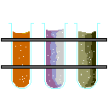
Gardening Organically
Catherine Wissner
UW Extension
Laramie County
Master Gardener Program

Slide 2
Growing Season in Cheyenne
90 to 141 growing days per season.
Cool nights.
About every 10 years a severe drought.
Average highs: May 65° June 74° July 84° August 82° Sept. 73°

Slide 3
Watering
Deep.
Use a small can to
measure watering
amount.
Be Consistent.

Slide 4
Soil is.
Air, water, decayed plant residue, organic matter, minerals, sand, silt, and clay.
Increasing soil organic matter typically improves soil health.
Healthy soils are porous, which allows air and water to move.
A balance ensures a suitable habitat for soil organisms that support growing plants.

Slide 5
Soil a vital natural resource
More than one million organisms in a single teaspoon of Earth, soil is the starting point for plant, animal and human life.
the Soil Health Institute.
  safeguard and enhance the vitality and productivity of the soil.
  provide research funding to better understand soil.
  www.soilhealthinstitute.org.

Slide 6
Soil - the Basics
Work only when dry to
avoid compaction.
Add organic matter.
Good drainage is a must.
HEALTHY SOIL =
HEALTHY PLANT

Slide 7
Soil Salinity
Measured in electrical conductivity (EC), or mmhos cm.
Non-saline 0-2
Very slightly saline 2-4
Slightly saline 4-8
Moderately saline 8-16

Slide 8
Salt Index
Fertilizer Material Relative Salt Index
Sodium Nitrate 100.0 bench mark
Ammonium Sulfate 69.0
Diammonium Phosphate 29.9
Monoammonium Phosphate 34.2
Potassium Chloride 116.2
Potassium Nitrate 73.6
Potassium Sulfate 46.1
K-Mag, Sul-Po-Mag 43.2

Slide 9
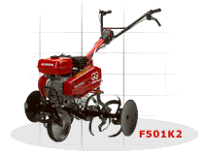
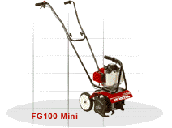
Soil - Do’s and Don’ts
Intense tillage physically disrupts the soil, increases aeration, which accelerates the decomposition of crop residues and soil organic matter.
Resulting in a net loss of organic matter.

Slide 10
Soil – Don’ts
NEVER USE*:
Lime (calcium).
Wood ash, fireplace ash, barbeque ash.
Lawn fertilizer in your vegetable garden.
Raw or fresh manures.
In Wyoming or western soils.

Slide 11
Organic Matter Benefits
Improves “buffering” capacity of soil: that is, keeps soil from “over-reacting”.
Supports the soil’s micro-biological activity (or the “life of the soil”).
Contributes nutrients, both minor and major.

Slide 12
Organic Matter
Benefits
Improves:
  Tilth.
    Soil that has the proper structure and nutrients to grow healthy crops.
  Condition.
  Structure of soil.
  Water and nutrients holding ability of the soil.

Slide 13
Organic Matter Benefits
Acids arising from the decomposition of the organic matter help to convert insoluble natural additives such as ground rock into plant-usable forms.
Releases nutrients slowly.
Helps vegetables survive stress, as from nematodes, heat, drought.

Slide 14
Organic Matter
What it Should Do
Provides adequate ground cover to protect against soil erosion.
Have a high rate of nitrogen fixation and good biomass production.
Down-side: you need 460 pounds of O.M. for a 1000 sq. ft. garden to raise the soil O.M. by 1%.

Slide 15
Soil pH
The pH of a soil is a measure of its alkalinity or acidity, a scale of 1 to 14.
7 is neutral.
1-<7 is acid >7 to 14 is alkaline.
Examples: lye 13., ammonia 11., baking soda 8.5., milk 6.6., wine 4.0., lemon juice 2.0.

Slide 16
Soil Microorganisms
Microorganisms are found in large numbers in soil.
Plaster (1992) estimates that one teaspoon of fertile soil (about one ml.) contains:
50 nematodes
62,000 algae
72,000 protozoa
111,000 fungi
2,920,000 actinomycetes
25,280,000 bacteria

Slide 17
Soil Microorganism
Transformation of organic materials.
Release nutrients.
Enhance nutrient uptake.
Almost every chemical transformation taking place in soil involves soil microorganisms.
Play an active role in soil fertility (carbon and nitrogen).

Slide 18
Soil Microorganism
Without microorganisms nutrients stay in cover crops and compost.
Soils would lose their porosity and water holding capacity, soil erosion would increase.

Slide 19
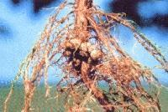
Soil Bacteria
Switch hitter of the soil: enzymatic transformers, oxidize or reduce.
Used for salt remediation, natural growth hormones, breakdown of petroleum based products in the soil.
Rhizobium, Azobacter, Nitrosomonas, Nitrobacter...

Slide 20
Soil Microorganism - Fungi
Fungi are responsible for most of soil fertility.
Decompose just about anything and release the nutrients contained within the materials back to the plant.
Workhorse: bind soil particles, soil tilth.

Slide 21
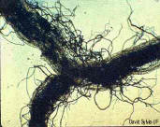
Mycorrhizae
Live in and around the root zone of plants, extending far out from the plant's roots with their own network of thread-like filaments known as hyphae.
Evolve in association with plants.
Increase the ability of plants to take up water and certain nutrients.
Protect associated plants from pests and diseases.

Slide 22
Mycorrhizae
Cannot survive long in bare-soil conditions.
Cannot thrive in conditions where soluble fertilizers have been used continually for many years.

Slide 23
Mycorrhizae
Strategies for improving mycorrhizae activity in your soil.
Use green plow down plants and mulch.
Refrain from using chemical fertilizers, w/high levels of phosphorus.
If the soils are degraded, consider adding quality compost.
For degraded sites, inoculate with commercially-available mycorrhizae.
Agroforestry Net, Inc. P.O. Box 428 Holualoa, Hawaii 96725 USA

Slide 24

Soil and Fertilizers
Three major plant nutrients contained in packaged fertilizers (N.P.K.).
(Ca), (Mg), (Fe), (B), (Mn) and (S), which plants need in lesser amounts.
Packaged fertilizers contain other substances such as organic matter or filler.
Most Fertilizers are Salts.

Slide 25
Nitrogen
Nitrogen is necessary for many functions including growth, fruit bud formation, fruit set, and fruit size.
Loss of N from high temperatures, runoff, de-nitrification. Mobile in soil.
Soil pH of 5.5 to 8.5.

Slide 26
Nitrogen
Nitrates and nitrites are nitrogen-oxygen chemical units, which combine with various organic and inorganic compounds.
Very soluble and does not bind to soils.
Has a high potential to migrate to ground water.

Slide 27
Nitrogen
On a molecular basis, nitrogen is taken up more than other nutrients.
Nitrogen type has a bigger effect on soil pH than other nutrients.
Nitrate nitrogen (NO3-N) can cause the soil-pH to increase, but only if it is taken up by the plant.
If plants are small, or stressed and not growing, nitrate has little influence on soil pH.

Slide 28
Nitrogen
Does not evaporate in water.
Nitrates/nitrites are likely to remain in water until consumed by plants or other organisms.

Slide 29
Phosphorus P205:
An essential ingredient of all cell protoplasm.
Important in fruit, flowers, and root growth.
Needs nitrogen to work best, pH of 6-7.
Moves from old leaves to new.
Soil moisture and temperature dependent.
Will increase the soil pH over time.

Slide 30
Soil – Phosphorus cont…
Phosphorus moves very little in the soil.
Too much can cause the fruit/vegetable to be bitter.
Vegetables typically remove 10-15 pds., of P., per acre per year.
Soil will retain excess phosphate for next year’s crop.
Compost and Vermi-compost best sources.
C.W. Basham CSU CES

Slide 31
Phosphorus - Facts
Phosphorus has no substitute.
It is not a renewable resource.
The vast majority of the world’s mineable phosphorus is in the North African country of Morocco.

Slide 32
Potassium or Potash
Potassium (K) fertilizer is often referred to as "pot-ash," a term coined by early American settlers who produced potassium carbonate by evaporating water filtered through wood ashes.
The ash-like crystalline residue remaining in the large iron pots was called "pot ash," and was used in making soap.
This process of making potash is registered as U.S. Patent No. 1.

Slide 33
Potassium what it does for Plants
Increases root growth.
Improves drought resistance.
Helps retard crop diseases.
Reduces water loss and wilting.
Increases protein content of plants.
Aids in photosynthesis.
Regulates production of high energy plant growth compounds.
Activates more than 60 enzyme systems. http://sanangelo.tamu.edu/agronomy/mg/potash.htm

Slide 34
Products on the Market.

Slide 35
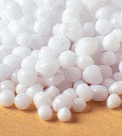
Urea 46-0-0
Produced through the reaction of ammonia (NH₃)and carbon dioxide (CO₂) +CO(NH 2) 2.
The area around a dissolved urea particle becomes a zone of high pH and ammonia.
This area is toxic to seed and seedling roots by the free ammonia that has formed.
Lost to the atmosphere if it remains on the soil surface.
Curtis J. Overdahl, George W. Rehm and Harvey L. Meredith U of M

Slide 36
Rock Phosphate
25 to 30 % phosphate, but only about 3 % is available to plants.
Depends upon how finely ground the material is, the pH and the biological activity of the soil.
It is less effective in soils that are too alkaline or have a low level of biological activity.
Colloidal phosphate, obtained from rock phosphate, has similar properties.
In Laramie County Soils, it stays a rock.

Slide 37
Potassium Chloride KCL
(aka, Muriate of Potash) One source of K
Most of the world reserves of K were deposited as sea water from ancient inland oceans evaporated, and the K salts crystallized into beds of potash. New Mexico, Utah, California.
An excess amount of potassium can lead to deficiency of magnesium (Mg), and high soil salt.
pH 6 on up.
Is mobile in plants.
High Salt Index.

Slide 38
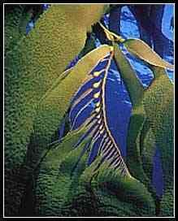

Kelp
All-natural, provides more
than 70 minerals, plant growth
regulators, vitamins, hormones,
and enzymes.
Provides a supply of naturally chelated nutrients.
1 - 0.1 - 2.
Work 1 lb. of kelp meal into each 100 sq. ft.

Slide 39
What’s in Kelp Analysis of Dry Kelp Feed Grade Aseophyllum Nodosum
Specs Provided By A.M.P.I.(Canada)
Moisture Content 12.93+or-0.27%
Copper ( ppm ) 3.00
Mineral Coateat 16.75+or-0.51%
Iron ( ppm ) 102.26
Oil Content 5.46+or-0.25%
Fat 5.42%
Crude Protein 5.93+or-0.19%
Ash 24.71%
Carbohydrate 58.93%
VitaminE (mgl00g) 6.40
Alginic Acid ~14.0%
VitaminA (IU/100g) +10
Total Nitrogen 1%
Ascorbic Acid 10.70(mg/100g )
Phosphoric Acid 1%
Cyanocbaiamin B12 0.02 (mg/kg)
Soluble Potash 4%
Pyridoxine B6 +0.03(mg/100g)
Crude Fibre 3.70%
Niacin B3 (mg/kg) 8.40
Calcium 1.32%
Riboflavin B2 0.04(mg/100g)
Phosphorus 0.13%
Thiamine B1 0.06(mg/100g)
Potassium 2.58%
Iodine (mg/kg) 730.00
Magnesium 1.00%
Chromium (ppm) 1.49
Sodium 3.80%
Fluoride(mg/kg) 22.00
Zinc (ppm) 35.40
Manganese(ppm) 4.00

Slide 40

Coffee Grounds
pH of 6.9.
C:N 20:1.
Add directly to the garden soil, filter too.
For composting purposes, consider coffee grounds "green" material similar to grass clippings.
1.5%N, 0%P, .5%K.
Bob Smith, WSU Master Gardener Program
Manager, Thurston County

Slide 41

Soil Sulfur
Essential element in supporting protein, enzymes, vitamins, and chlorophyll in plants, and nodule development in legumes.
Soil that is cold and wet or sandy can produce sulfur deficiencies.
Is needed by plants in about the same quantities as phosphorus.
Sulfur is quite soluble and moves in the soil.

Slide 42
Soil Sulfur
To drop the pH of 100 square feet.
To much - toxic to the soil micro-life.
1 - 4 lbs per 100 sq ft.
Sulfur sources: ammonium sulfate, gypsum, soil sulfur.
http://www.uidaho.edu/wq/wqfert/cis922.html
Amounts of elemental S to decrease soil pH.
Initial soil pH | Desired soil pH | S per 100 ft²
 |  | (lb) | (cups)
7.5 | 6.5 | 1.5 | 3
8.0 | 6.5 | 3.5 | 7
8.5 | 6.5 | 4.0 | 8
9.0 | 6.5 | 6.0 | 12

Slide 43
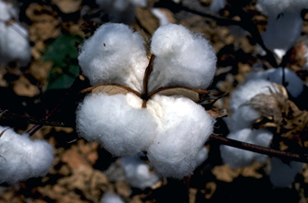
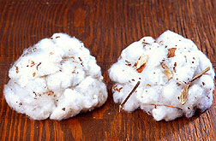

Cottonseed Meal
By-product from the extraction of oil from whole cottonseed.
7 – 2.5 – 1.5
Slow release of nutrients.
Used as an all-purpose fertilizer for plants that require a lower soil pH.
Potatoes and Roses, any acid loving plants.
Use approximately 10 - 15 lbs. per 100 sq. ft.

Slide 44
Soil Additives - others
    Gypsum (calcium sulfate) will keep the soil pH the same.
    Limestone (calcium carbonate) will raise the soil pH.
    Epson salts (magnesium sulfate) for Magnesium deficiency.

Slide 45
Peat Moss
pH of 3.5 to 4.5.
In a garden, work 2" of peat into the top 6" of soil.
Aerates plant roots by loosening heavy clay soil.
Adds body to sandy soil.
Saves water by absorbing
and holding moisture.

Slide 46

Humates
Humates are developed from decomposed prehistoric deposits found in the western United States.
Natural compost piles first become peat, then humate, then lignite and eventually coal.
Not a lot of detailed research.

Slide 47
Humates
The humic acids (humic, ulmic and fulvic)
are essential to plants in three basic ways:
Humic acid enables plants to extract nutrients from the soil.
Ulmic acid stimulates and increases root growth.
Fulvic acid helps plants overcome stress, enhances the bio-availability of important trace minerals and their uptake.

Slide 48
Lignite, (a. k. a.) leonardite,
Low rank coal between peat and sub-bituminous.
Some qualities as a fertilizer due to its high humic acid.
3 to 45 pounds per 1000 sq. ft.
pH determinate?

Slide 49



Fish
Fish emulsion is a concentrated liquid made from fish scraps.
The content may vary with the manufacturer.
A source of slow-release (water-insoluble) nitrogen and trace elements.
It can be used as a foliar fertilizer.

Slide 50


Fish Bone Meal
Contains dried and ground fish scraps, crab meal and fish manure.
  It contains about 6 to 10 % nitrogen, 4 to 10 % phosphate and about 1% potassium.
  Fish bone meal also supplies other minor and micronutrients important for plant growth.

Slide 51
Blood Meal
Obtained from slaughterhouses.
Contains 12 % nitrogen, 2 % phosphate and 0.6 % potassium
  12-2-.6.
It is very soluble, excessive amounts will burn plant foliage.
Use 5 lbs, per 100 sq. ft .

Slide 52
Bone Meal
A white powder obtained from ground, raw, or steamed animal bones.
About 22 % phosphate. 0-22-0.
Raw bone meal will release nutrients more slowly than steamed bone meal.

Slide 53
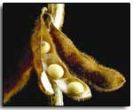
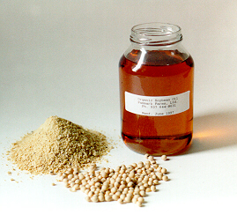
Soybean Meal
N 7% -P 2% - K1% slow releasing.
Best to work in prior to planting.
Use from 5 - 15 lbs. per 100 sq. ft.
More soybeans are grown in the U.S. than anywhere else in the world.

Slide 54
Natural Weed Control
Corn Gluten Meal
Iowa State University researcher Nick Christians.
Protein part of the corn: corn-gluten meal (CGM), a corn milling byproduct-could inhibit root growth.
Contains 9 - 10% nitrogen by weight, ideal "weed and feed" product. *
Applied pre-emerge in spring and fall, applied at 1 lb./100 sq. ft. * CSU soil lab recommendation.

Slide 55
Grape Pomace
Improves alkaline soils.
By-product of wine.
Very acidic, pH 3.0.
N 3%- P 1%- K2%.
Reduction of nematode population on plant roots and in the soil? ISHS Acta Horticulturae 532: International Symposium on Chemical and Non-Chemical Soil and Substrate Disinfectation .

Slide 56


Feathers
Feather meal is made of dried and ground chicken feathers and contains about 11-15 % nitrogen (only).
Hydrolysed feather meal is steam-treated to make its nitrogen more soluble.
10-15 lbs. per 1,000 sq. ft.

Slide 57

Alfalfa
Alfalfa pellets, available as an animal feed from farm suppliers.
2.7 % nitrogen
0.5 % phosphate
2.8 % potassium
Dry, use at 5 pounds
Per 100 square feet.* CSU soil lab recommendation.

Slide 58
Alfalfa
Very high in vitamins, plus Ca, Mg, and other valuable minerals.
Includes sugars, starches, proteins, fiber and 16 amino acids.
Contains plant growth regulators.
use around; roses, iris, vegetables, trees, or shrubs.
Make alfalfa tea by soaking 1 pound of alfalfa meal per 5 gallon of water.

Slide 59
Iron Additives
Miller's FerriPlus (distributed by Jirdon's $15 a lb.+/-).
KEREX Sequestrine 138 Fe Super Iron concentrate.
Becker Underwood Sequestrine 138.
Sequestar 6% iron chelate WDG.
Ferrous sulfate is 30% to 20% Fe.

Slide 60
Greensand and
Granite Dust
Very slowly available and less effective in soils that are alkaline or have a low level of biological activity.
If the rock powders are finely ground, they will break down faster.
Greensand contains 5 to 7 % potassium, a large quantity of magnesium and many trace minerals.
Granite dust contains 3 to 5 % potassium, It also supplies trace minerals.

Slide 61
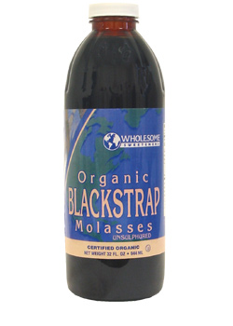
Molasses
3 types - unsulphured, sulphured and blackstrap.
Blackstrap molasses is from the third boil and only has a commercial value in the manufacture of cattle feed and other industrial uses.
Has more complex sugars which help the beneficial fungi.

Slide 62
Molasses
Feeds fungi and/or bacteria in the soil.
Better resistance to many insect pests as well as exhibit higher stress tolerances.
Use rate from 3-5% solution for more bacteria in the soil.
5 +% for more fungi in the soil.
Use liquid molasses, not dried feed stock grade.
Dr. Elaine Ingham, Soil Food Web

Slide 63
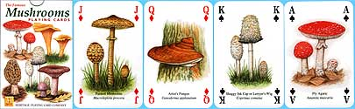
Mushroom Compost
High in soluble salts, which can kill germinating seeds and harm salt- sensitive plants.
Mushroom compost varies from company to company.
2-1-1.
pH 6.8 (?)
John Hart, soil scientist, Oregon State University Extension

Slide 64
Animal Manure- and organics
§205.203 Soil fertility and crop nutrient management practice standard.
(1) Raw animal manure, which must be composted unless it is:
(i) Applied to land used for a crop not intended for human consumption;
(ii) Incorporated into the soil not less than 120 days prior to the harvest of a product whose edible portion has direct contact with the soil surface or soil particles; or
(iii) Incorporated into the soil not less than 90 days prior to the harvest of a product whose edible portion does not have direct contact with the soil surface or soil particles.

Slide 65
Animal Manures
Pathogens can be transferred from animal manures to humans.
Salmonella, listeria and E.coli 0157:H7, as well as parasites, such as roundworms and tapeworms, have been linked to applications of manure to gardens.
Bacteria can live in soil for up to 1 year or more, depending on temperature and soil conditions.
Never apply fresh manure after the garden is planted.
Thoroughly wash raw vegetables before eating.
http://gardening.wsu.edu/stewardship/compost/manure/manure2.htm
http://www.gaps.cornell.edu/Educationalmaterials/Samples/FSBFEngMED.pdf

Slide 66
Sawdust, Wood Shavings, Horse Bedding Pellets.
Caution:
  C/N ratio 22:6.
  Salts EC 2.56.
  pH 5.5 to 7.5.
  N 14, P 4, K 20. (varies on age of sawdust).
  Some trace elements.
  Organic Matter 68.6%.
  Can very greatly from tree to tree and over time
    and from Pine and Spruce
  Pacific Soil Analysis Inc. Dr. WA Herman P.Ag
  http://scholar.lib.vt.edu/ejournals/JARS/v29n1/v29n1-orr.htm

Slide 67
Earthworms
A typical nutrient analysis of Earthworm casts is:
C:N ratio 12–15:1;
1.5%–2.5% N, 1.25%–2.25% P₂O₅ and 1%–2%, K₂O
Slow-release structure of earthworm casts allows nutrients to be released in sync with plant needs.
http://www.omafra.gov.on.ca/english/engineer/facts/10-009.htm

Slide 68
Earthworms
The earthworm has no lungs and takes in oxygen through its moist skin – it is a skin breather. If it dries out, it will suffocate.
They cannot tolerate heat and sun and so during the summer they come up to the surface only at night.
Pesticides applied to control turf diseases or insect pests may severely affect earthworms.
https://vimeo.com/110880643

Slide 69

Leaves
Amended into the soil they contain calcium, phosphorus, potassium, Boron, Iron, Zinc and magnesium
Slow release of nutrients. But may need to add additional N.
No change in soil pH
http://www.spectrumanalytic.com/support/library/ff/Plant_Nutrients_in_Municipal_Leaves.htm

Slide 70
Biochar
produced through gasification — processes that heat biomass in the absence (or under reduction) of oxygen.
The carbon in Biochar resists degradation and can hold carbon in soils for hundreds to thousands of years
Amendment to improve yield, but only for plants that require high potassium and elevated pH.

Slide 71
Bagged Manure Compost
May vary from bag to bag.
Tends to be very salty.
Can contain high levels of plant-available N.
  can inhibit flowering and fruit set.
Apply 2-3” and mix into the top 6-8” of soil.
1 part compost to 3 parts soil.
Jean Reeder, PhD CSU, March 2011

Slide 72
Green Manure
What?
Are a biological source of nitrogen that reduces the amount of fertilizer required for the following crop.
Increase in soil organic matter increases nutrient availability to plants.

Slide 73
Green Manure Benefits
Field studies have shown between 10 - 20% of the total annual nitrogen added to the soil as green manure is used by the first crop.
An additional 64% of the nitrogen can be found in the top soil 14 months after green manuring.
Nitrogen becomes available as plant residues continue to decompose.

Slide 74
Green Manure Crops, Season of Growth, Amount of Seed, and Type.
Crop | Season | Seed (lbs./acre) | Type | Nitrogen (lbs./ton dry material)
Buckwheat | Summer | 75 | Nonlegume | 14
Crimson clover | Winter | 15 | Legume | 45
Rye | Winter | 75 | Nonlegume | 21
Southern pea | Summer | 90 | Legume | 60
Soybean | Summer | 75 | Legume | 46
Sudan grass | Summer | 25 | Nonlegume | 28
Vetch | Winter | 30-50 | Legume | 62
Wheat | Winter | 75 | Nonlegume | 20

Slide 75
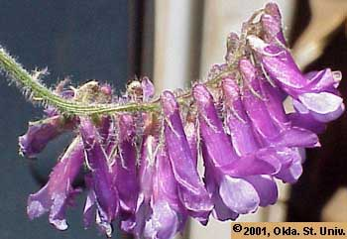
Cover Crop
Vetch
  Hardy winter annual.
  Flowers from April to July.
  Seed matures August to October.
  Self-reseeding cover crop.
  Vetch requires inoculation.
  Vetch taproots can extend 3-5 ft.

Slide 76
Cover Crop
Winter Wheat
18-22 lbs. of wheat for a 100 ft. x100 ft. (10,000 sq. ft.).
Sow in the fall Sept/October.
Turn under in March.
Approximately 20%N.

Slide 77
Composting
Green matter, like grass clipping, kitchen waste, high in nitrogen.
Dry ingredients to prevent clumping, like leaves and straw, rich in carbon. Soil.
Add water, compost pile should remain damp but not wet.
Air: stir by turning or moving the pile occasionally. Oxygen helps the microbes work better. Should be turned every 3 to 10 days.

Slide 78
Items NOT to Be Used in the Compost Pile
Meat
Dairy
Colored paper
Coal
Charcoal and fireplace ash

Slide 79
Items NOT to Be Used in the Compost Pile
Diseased plants.
Always know where your compost
materials are coming from.
Picloram (Tordon and Grazon) can remain in the soil for 3 years or more, very persistent, highly soluble, and easily moved by rainfall. Used by commercial operations to control weeds.

Slide 80
How to Build a Compost Pile and How Big to Build It.
Convenient size to work with, about 5’x3’, should not get below one cubic yard in size.
The top should be left flat or with a slight depression in the center to catch rain or added water.
Keep it moist, but not wet.
Compost will begin to heat after 2 or 3 days.
After 10 days, fork it over, mixing the parts to obtain uniformity.

Slide 81
Carbon and Nitrogen
Microorganisms get their energy from:
Carbohydrates such as cellulose, lignin and complex sugars in plant residues, high in carbon.
Nitrogen from manure, kitchen vegetables, and fruit scraps.

Slide 82
Carbon and Nitrogen
If there is too little N the microbial population will not grow to an optimum size and decomposition will slow down.
Too much N allows rapid microbial growth and speeds up decomposition, it can result in depleted oxygen and odors as the excess N is given off.
The optimum C:N ration is about 30:1

Slide 83
Finished Compost
Can take a couple of weeks a month or a year depending on the materials, time of year, and moisture.
Broken down into a homogenous mixture and no un-decomposed leaves or other material may be seen, it is ready for use.
Should have a sweet, earthy smell.
Use-Half inch to ¼ inch deep.

Slide 84

Compost Tea
Must be very well aerated to work.
Soaking compost in a bucket creates problems.
Anaerobic vs. aerobic.

Slide 85
Compost Tea
Compost tea is not:
A pesticide, but reduces the use of pesticides.
A fertilizer, but can reduce the use of fertilizers.
An herbicide, but can reduce the use of weed killers.

Slide 86
Mulching
Conserves water.
Controls weeds.
Moderates soil temperatures.
Reduces compaction.
Reduces crusting of soil.

Slide 87
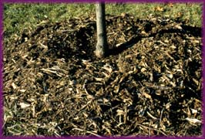
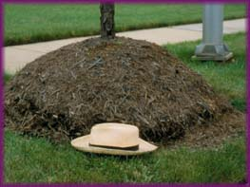
Mulch
Grass clippings,
shredded leaves,
crushed corn cobs,
pine needles,
straw and hay
wood products - chips, bark, sawdust,
Synthetic Mulches
Plastic – black*, clear
Newspaper, rock, and pebbles
Landscape fabric

Slide 88
Disease and Pest Control
  Use disease resistant veggies, perennials, trees.
  Mulch.
  Water at base of plant.
  Good sanitation, don’t leave last year’s debris to over winter in the garden.
  Keep your tools clean, sanitize if necessary.
  Do rotate veggies / annuals on a 3-year plan.
  Soil test.
  Don’t over feed your plants.
  Don’t over water your plants.
  HEALTHY SOIL = HEALTHY PLANT

Slide 89



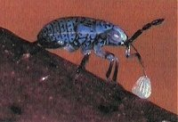

Beneficial Insects and Non-Toxic Solutions
Ladybugs
Green lacewings
Big-eyed bug
Praying mantis
These are generalists, attack pest in all stages of development.

Slide 90
Pest Control
Safer soap or a homemade soap mix.
Bacillus thuringiensis (Bt).
Diatomaceous earth (DE).
Plant based insecticides.
Tobacco products.
Flowers.
Garlic.
Flour.

Slide 91
Pest Control
Pheromone traps.
Sticky traps.
Fly and yellowjacket traps.
Boric acid, borates, borax.
Horticultural oils.

Slide 92
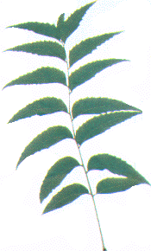
Neem Oil
Derived from the Azadirachta indica tree.
Flies, mosquitoes, caterpillars, true bugs, locusts, grasshoppers, aphids, weevils, moths, roaches.
Rust, powdery mildew.

Slide 93
Natural Weed Control - Vinegar
Horticultural vinegar 20% acetic acid (difficult to handle).
A staple in organic weed control.
Some add a yucca extract in their vinegar, which increases effectiveness by acting as a spreader-sticker.
Is a non-selective product used for spot weed control, will kill any green material it comes in contact with. Apply cautiously!

Slide 94
Tips for the garden
Check the fertilizer analysis on the bag or container.
Apply the fertilizer at the rates given on the fertilizer container.
Work fertilizer well into the soil.
Don't guess at rates; measure or weigh the fertilizer product.
Healthy Soil = Healthy Plant.

Slide 95
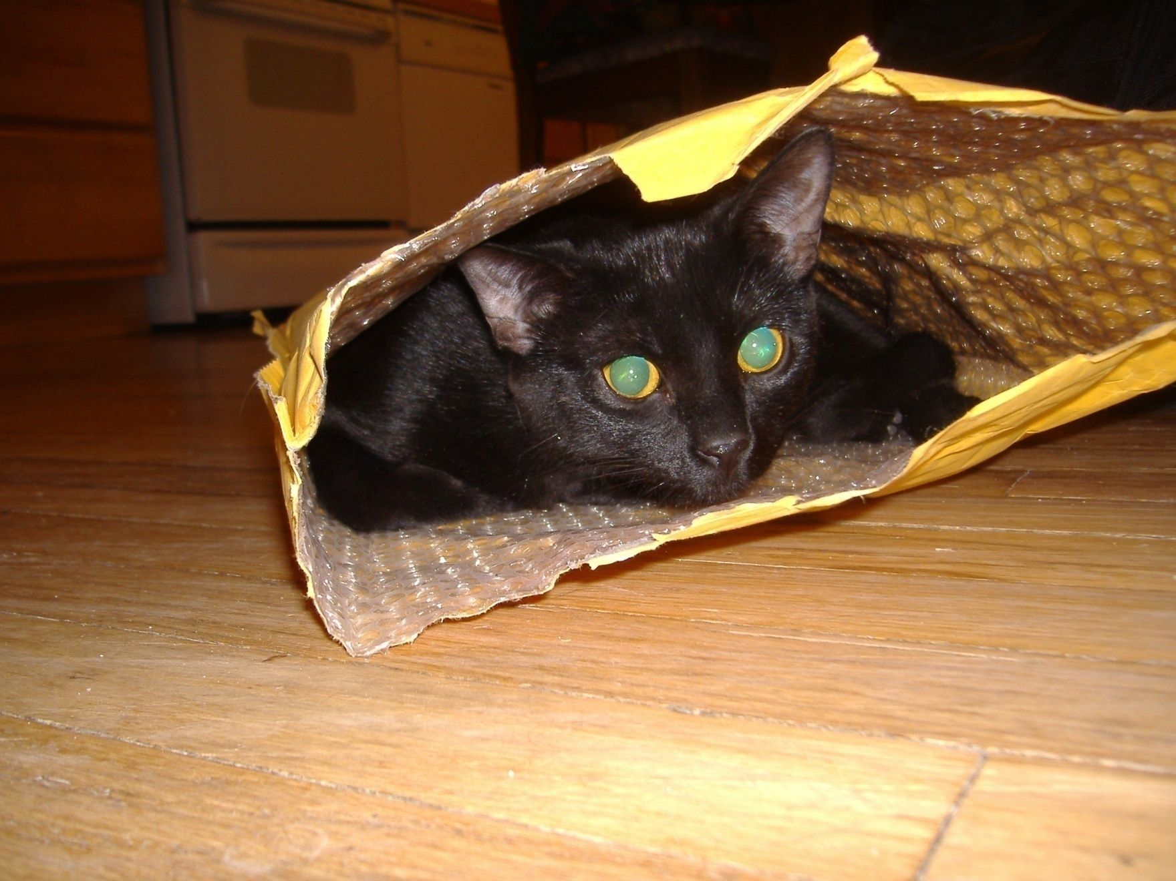

Happy Gardening

